Slide 1
Unlocking the Mysteries of Excel…….
Please use the code to sign in….It’ll be fun!

Slide 2
Example…Customer Order History
Customer Input: This is where order information goes directly.
Pivot Tables: Orders are broken down by (1) Customer Totals, (2) Item Price
Input Calculation: Order Totals are calculated for each order, based on Item Number, Item Cost, Loyalty Discounts, Big Spender Discount, Shipping and Sales Tax by State.
Customer Information: Customer Information listed by phone number (for use in look-ups)
Product Information: Items for sale listed by item number, description, price.
Order History: All information tabulated by order number.

Slide 3
Example…Customer Order History…Continued
Create Customer Claim: This will create a customer claim number based on information provided (encoded)
Existing Customer Claim: This will decode customer claim numbers to extract relevant information.
Individual Customer History: Available by macros when accessed for use while processing customer claims.

Slide 4
Conditional (“if”) statements:
=if(logical argument, command if TRUE, command if FALSE)
This will allow you to enter an argument, based on cell information, that will return one value if true, or (optional) a different value if false.
Helpful:
And(Logical1, Logical2, …) will return a TRUE if all logical statements are true.
Or(Logical1, Logical2, …) will return a TRUE is any logical statements are true.

Slide 5
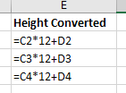
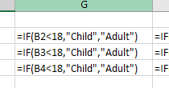
Conditional (“if”) Statements

Slide 6
Vertical Look-Up
=vlookup(Lookup Value, Lookup Table, Column Index)
This will allow you to search for a particular value in a table and return any other column.
[The look-up column, first column, should be sorted from A to Z or lowest value to highest value]
Be careful to use Absolute Cell References when indicating your Lookup Table
A1:G6 would increment with different cells.
$A$1:$G$6 would not change cell addresses.

Slide 7
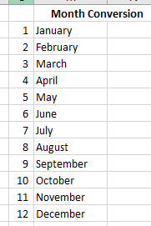
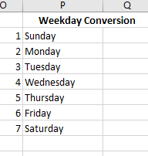
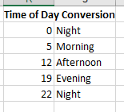
Vertical Look-Up

Slide 8
Pivot Tables
These can be accessed through Insert and then Pivot Table
These will allow you to summarize, collect, and calculate your raw data into an easy to read format, depending on what you are trying to present.

Slide 9
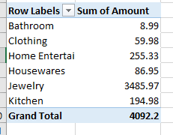
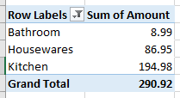
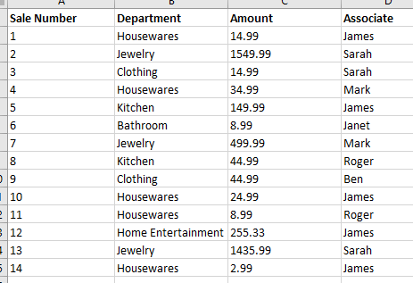
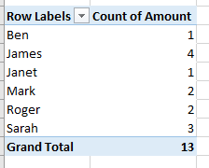
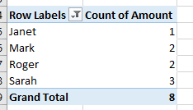
Pivot Tables
Aggregated by Department
Filtered by Department
Raw Data
Aggregated by Associate
Filtered by Associate

Slide 10
When you signed in…..
We are going to use the information you provided when you signed in to try some of this out.

