Slide 1
MATH 1311
Calculator Review

Slide 2
Calculator
You will need a graphing calculator for this course…preferably TI 84.
For quizzes, homework, and classwork, you may use the Desmos App instead….then “time-share” a graphing calculator with some friends for testing!

Slide 3
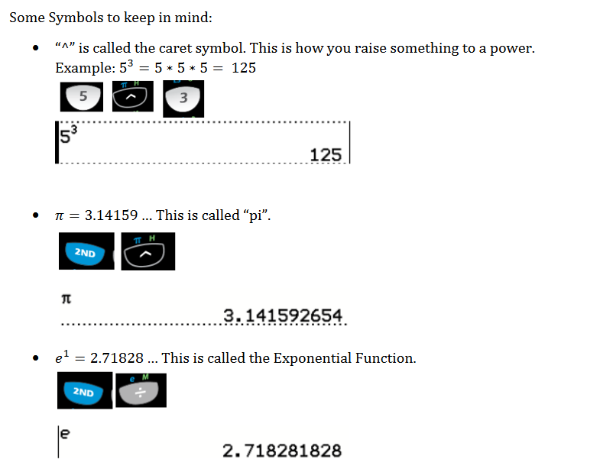
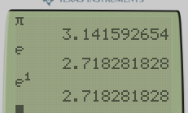

Slide 4
Names of Place Values

Slide 5
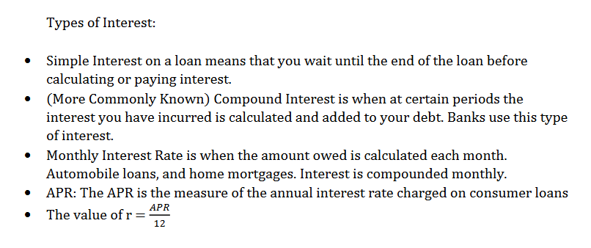
Simple Interest:
I = P₀ * r * t
Compound Interest:
P_{t} = P₀(1 + ^{r}/_{n})^{nt}

Slide 6
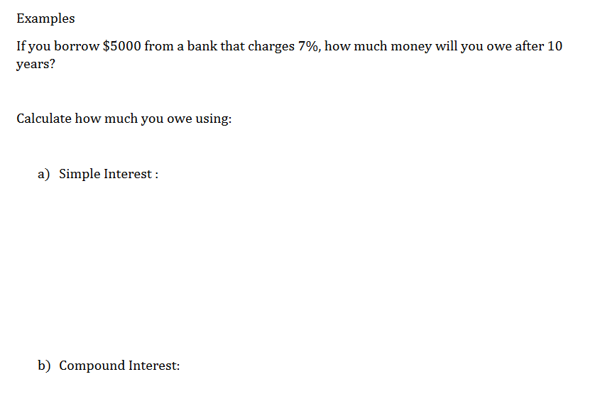

Slide 15
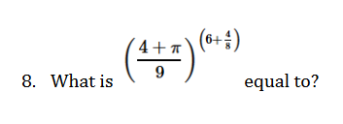

Slide 16
