Slide 1
MATH 1311
Final Exam Review

Slide 2
An exponential function can be used to model the number of bacteria in a petri dish. The function: b(s, r, t) would represent the number of bacteria in the dish after t minutes have elapsed, with an initial value of s and a growth rate of r. Describe what b(1500, 0.04, 8) would represent.

Slide 3
The table below shows the number of trees in a forest, where t is measured in years from 1985 and N(t) is measured in thousands of trees.
Find the average rate of change between t = 5 and t = 10.
Use this to estimate the value for t = 6.

Slide 4
The table below shows the number of trees in a forest, where t is measured in years from 1985 and N(t) is measured in thousands of trees.
Does this table of values represent a linear function, an exponential function, or neither.
Find the function, N(t), if it either linear or exponential.

Slide 5
To book a catering hall, a company charges $250 per room rented and $1.50 per guest.
Write a function that will represent this situation.

Slide 6
To book a catering hall, a company charges $250 per room rented and $1.50 per guest.
Determine the cost of renting 3 rooms for an event that will have 200 guests.

Slide 7
Consider the function: f(x) = 2^{x+3} – 7
What is the initial value of the function?

Slide 8
Consider the function: f(x) = 2^{x+3} – 7
What is the limiting value (if it exists) of the function?

Slide 9
Solve the following for x: 5x + b = c

Slide 10
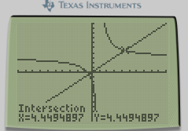
Determine all solutions to the following: $$\frac{3x+2}{x−1}=x$$

Slide 11
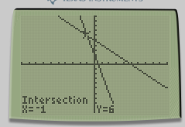
Solve the system of equations: $\begin{matrix}4x+y=2 \\ y=5−x\end{matrix}$

Slide 12
A ball thrown into the air has the following heights for specific t-values during its flight.
Determine the quadratic regression of the path of the ball.

Slide 13
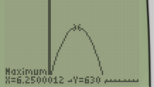
A ball thrown into the air has the following heights for specific t-values during its flight.
Use the regression to determine the maximum height of the ball, and when it occurs.

Slide 14
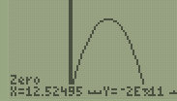
A ball thrown into the air has the following heights for specific t-values during its flight.
Determine when the ball hits the ground.

Slide 15
The façade of a house has walls that are 15 feet in height, 40 feet apart from one another. The peak of the roof is exactly halfway between the walls. What is the slope of the roof? (Assume a positive slope.)

Slide 16
The amount of butterflies in a nature preserve is increasing by 2% every month.
By what percent will it increase by the end of the year?

Slide 17
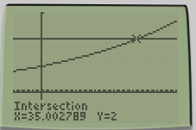
The amount of butterflies in a nature preserve is increasing by 2% every month.
How many months will it take for the butterfly population to reach double its original amount?

Slide 18
Find the rate of change for y = 3^{x} at the value of x = 2. Use a interval of 1.

Slide 19
If ^{df}/_{dx} is evaluates to -2 when x = 3, what can you say about f(x) when x = 3?

Slide 20
The following graph shows f(x). Describe the value of ^{df}/_{dx} when x = 3.

Slide 21
Determine the value of f(g(x)) and g(f(x)) for the functions: f(x) = 5x – 3 and g(x) = 2x + 5

Slide 22
Determine the value of f(g(x)) and g(f(x)) for the functions: f(x) = 5x – 3 and g(x) = 2x + 5
Determine the values of f(g(8)) and g(f(8)).

Slide 23
A function has ^{df}/_{dx} = -2f(x) where f has an initial condition of 4. Determine its equation.

Slide 24
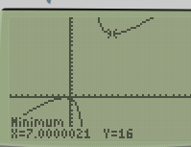
Determine relative minimum value of: $$f\left(x\right)=\frac{x^{2}+2x+1}{x−3}$$

Slide 25
Are the following polynomial? If so, give the degree.
f(x) = 5x³ + 4x² – 2x + 1
g(x) = 3x + 5
h(x) = 4^{x}
i(x) = x^{½} + 3x³
j(x) = 4/x
k(x) = -8x³ + 5x⁶ – 11x⁷

Slide 26
Construct a power function of the form: f(x) = a x^{k}, where f(2) = 40 and f(4) = 320.

Slide 27
Construct a power function of the form: f(x) = a x^{k}, where f(2) = 40 and f(4) = 320.
Find the value of f(8).

Slide 28
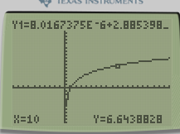
Model the following data with a logarithmic function:
Use this function to determine the value of f(10).

Slide 29
A logistic function has an initial value of 15, a limiting value of 35, and (assuming lack of constraints) a constant growth rate of 2%. Determine its equation.
Keep in mind: b = ^{K}/_{N(0)} – 1 and r = ln(growth factor).

Slide 30
A logistic function has an initial value of 14, a limiting value of 38, and (assuming lack of constraints) a constant growth rate of 2%. Determine its equation.
Determine when and for what value the function will obtain it maximum growth yield.

Slide 31
A line has a slope of 12 and passes through the point (4,5) and (k, 197). Determine the value of k.

