Slide 1
MATH 1311
Section 1.2

Slide 2
Functions Given by Tables

Slide 3
Average Rate of Change

Slide 4
Limiting Values

Slide 7
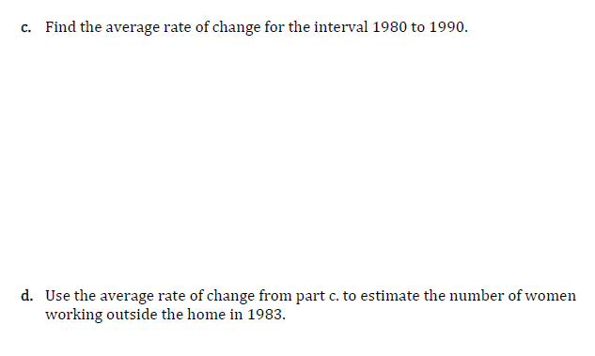

Slide 9
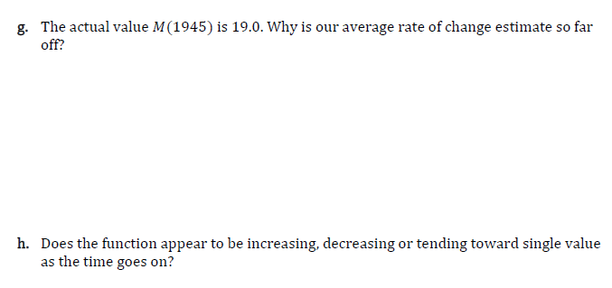

Slide 11
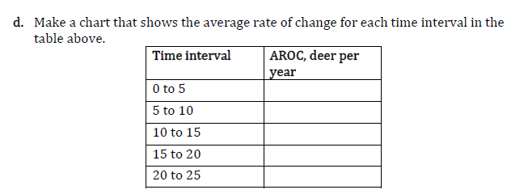

Slide 12
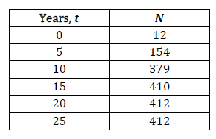

Slide 13
The world population, P(y), is given by the following table:
Year | 1955 | 1960 | 1965 | 1970 | 1975 | 1980 | 1985 | 1990 | 1995 | 2000 | 2005 | 2010 | 2015 | 2018
Population (Billions) | 2.77 | 3.03 | 3.34 | 3.70 | 4.08 | 4.46 | 4.87 | 5.33 | 5.75 | 6.15 | 6.54 | 6.96 | 7.38 | 7.62
a. Determine the value of P(1965) and describe its meaning:
b. Describe, in function notation, the population at the year 1995. Determine the value.
Source: Worldometers, UN Department of Economic and Social Affairs, Population Division, 2017

Slide 14
The world population is given by the following table:
Year | 1955 | 1960 | 1965 | 1970 | 1975 | 1980 | 1985 | 1990 | 1995 | 2000 | 2005 | 2010 | 2015 | 2018
Population (Billions) | 2.77 | 3.03 | 3.34 | 3.70 | 4.08 | 4.46 | 4.87 | 5.33 | 5.75 | 6.15 | 6.54 | 6.96 | 7.38 | 7.62
c. Find the Average Rate of Change between 1975 and 1980.
d. Estimate the population in 1983.
e. Find the average rate of change between 2010 and 2015.
f. Estimate the population in 2014.

Slide 15
The world population is given by the following table:
Year | 1955 | 1960 | 1965 | 1970 | 1975 | 1980 | 1985 | 1990 | 1995 | 2000 | 2005 | 2010 | 2015 | 2018
Population (Billions) | 2.77 | 3.03 | 3.34 | 3.70 | 4.08 | 4.46 | 4.87 | 5.33 | 5.75 | 6.15 | 6.54 | 6.96 | 7.38 | 7.62
g. Is there are faster rate of population change between 1975 and 1980 or between 2010 and 2015?
h. Does there appear to be a limiting value? If so, what is its approximate value?

