Slide 1
MATH 1311
Section 1.3

Slide 2
Functions Given by Graphs

Slide 7
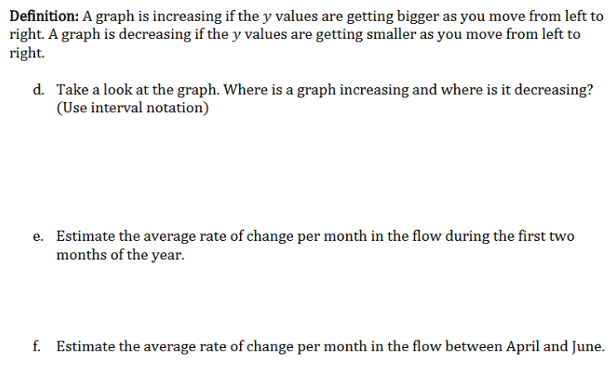

Slide 10
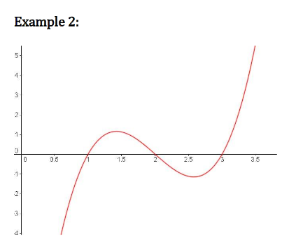

Slide 11
Popper #01:
Question 1: Interval where concave up?
a. (0, 6) b. (0, 5)&(7, 10.5)
c. (10, 12) d. (0,6)&(10,12)
Question 2: One interval where concave down?
a. (5, 7) b. (0, 5)&(10, 12)
c. (4, 10) d. Never
Question 3: Point of Inflection?
a. (6, 2100) b. (4, 500)
c. (2, 400) d. (5, 1000)
Question 4: Second Point of Inflection?
a. (12, 350) b. (7, 1500)
c. (9, 600) d. (9.5, 400)

Slide 12
Consider the following graph:
Determine the intervals where the graph is:
increasing
decreasing
concave up
d. concave down

Slide 13
Consider the following graph:
Determine the following:
e. where is a relative maximum?
f. what is the relative maximum?
g. where is the relative minimum?
what is the relative minimum?
i. where is the point of inflection?

Slide 14
Consider the following graph:
j. What is the value of f(2)?
k. What is the value of f(6)?
What x-values correspond to f(x) = 30?
What x-values correspond to f(x) = 10?
Does the function have a limiting value?

