Slide 1
MATH 1311
Section 1.3

Slide 2
Functions Given by Graphs

Slide 10
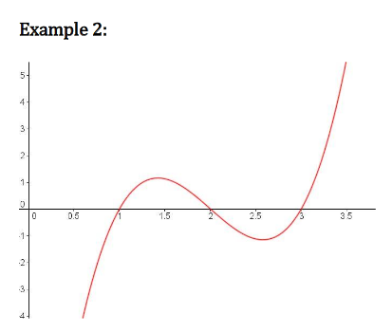

Slide 11
Popper #2:
Question 1: Interval where concave up?
a. (0, 6) b. (0, 5)&(7, 10.5)
c. (10, 12) d. (0,6)&(10,12)
Question 2: One interval where concave down?
a. (5, 7) b. (0, 5)&(10, 12)
c. (4, 10) d. Never
Question 3: Point of Inflection?
a. (6, 2100) b. (4, 500)
c. (2, 400) d. (5, 1000)
Question 4: Second Point of Inflection?
a. (12, 350) b. (7, 1500)
c. (9, 600) d. (9.5, 400)

Slide 12
Consider the following graph:
Determine the intervals where the graph is:
increasing
decreasing
concave up
d. concave down

Slide 13
Consider the following graph:
Determine the following:
e. where is a relative maximum?
f. what is the relative maximum?
g. where is the relative minimum?
what is the relative minimum?
i. where is the point of inflection?

Slide 14
Consider the following graph:
j. What is the value of f(2)?
k. What is the value of f(6)?
What x-values correspond to f(x) = 30?
What x-values correspond to f(x) = 10?
Does the function have a limiting value?

Slide 15
Consider the following graph [Popper 3]:
For what intervals is the function increasing?
For what intervals is the function decreasing?
For what intervals is the function concave up?
For what intervals is the function concave down?
a. (0, ∞) b. (-1, 1) c. (-∞, -1)U(1, ∞) d. (-∞, 0)

Slide 16
Consider the following graph [Popper 3]:
5. What is the location of the relative maximum?
What is the value of the relative maximum?
What is the location of the relative minimum?
What is the value of the relative minimum?
a. 0 b. 10 c. 20 d. None

Slide 17
Consider the following graph [Popper 3]:
9. Is there a limiting value? a. yes b. no
10. What is the limiting value? a. 0 b. 10 c. 20 d. None

