Slide 1
MATH 1311
Section 2.1

Slide 2
Tables and Trends

Slide 3
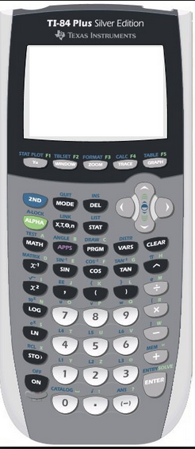

Slide 4
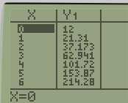
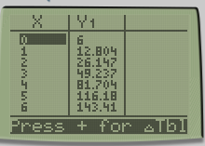

Slide 8
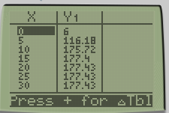

Slide 10
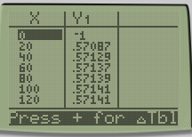

Slide 12
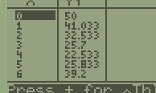

Slide 13
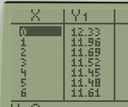

Slide 14
Popper #06
1.
a. R(d) = d^{x}(27-d) b. R(d) = d^{x}(28-d) c. R(d) = d^{x}(27) d. R(d) = d^{x}(d-1)
2.
How much should the owner charge for largest revenue?
a. $14 b. $10 c. $27 d. $5
What is the largest revenue?
a. $1560 b. $150 c. $220 d. $196
3.

