Slide 1
MATH 1311
Section 2.3

Slide 2
Solving Linear Equations

Slide 10
Popper 08:
Solve the following for x:
ax + b = 5
ax + bx = c – d
a(x – 3) = 10
abcx + ab – cd + ef = ghijk
a. $\frac{13}{a}$
b. $\frac{c−d}{a+b}$
c. $\frac{ghijk−ab+cd−ef}{abc}$
d. $\frac{5−b}{a}$
e. $\frac{10}{a}+3$

Slide 11
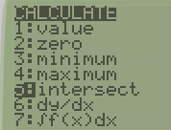

Slide 12
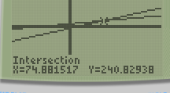

Slide 13
Use the Calculator to solve the following:
Popper #09:
2x + 6 = 9
2(x + 6) = 9
3x + 5 = 2x – 5
2x + 1 = -5x – 3
Choices:
a. -10
b. 1.5
c. -0.571
d. -1.5

