Slide 1
MATH 1311
Section 2.4

Slide 2
Solving Non-Linear Equations

Slide 3
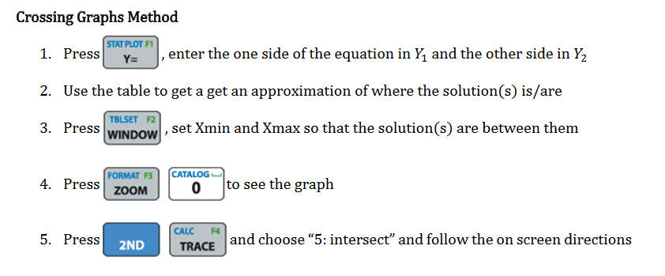

Slide 4
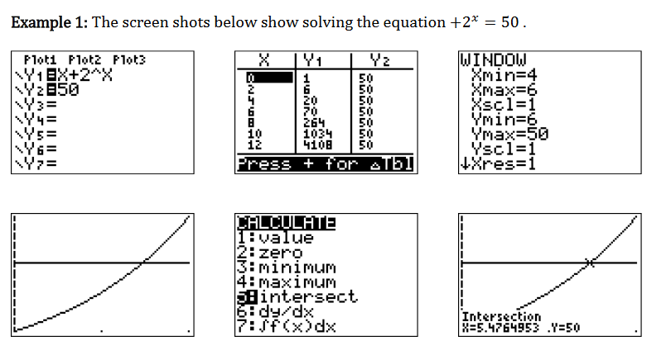
x

Slide 5
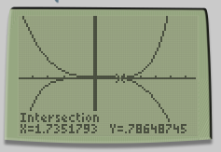
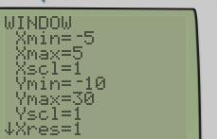
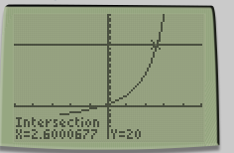

Slide 6
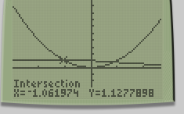
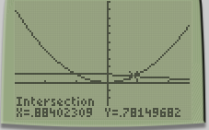
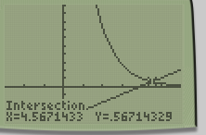
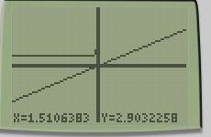

Slide 7
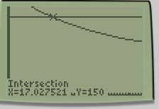
Popper #11
Question 1:
Answers rounded to the nearest minute:
a. 75 minutes b. 17 minutes c. 125 minutes d. 100 minutes

Slide 8
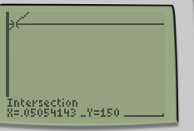
Popper #11…continued
Question 2:
Answers rounded to the nearest percent:
a. 5% b. 10% c. 15% d. 20%

Slide 9
Optimization
Finding the optimal values of a function means to find the highest or lowest within a given range of values.
The easiest way to do this is using the calculator.
Once a function is plotted, select 2nd → CALC → Minimum
You will be prompted to enter the a starting x-value, stopping x-value and a guess (optional).

Slide 10
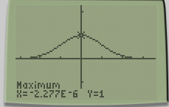
Find the maximum value (and where it occurs) of $f\left(x\right)=e^{−\frac{x^{2}}{2}}$

