Slide 1
MATH 1311
Section 2.4

Slide 2
Solving Non-Linear Equations

Slide 3
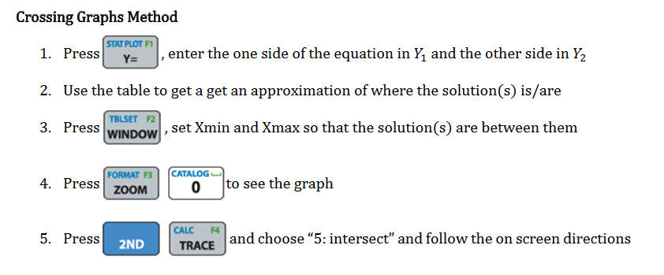

Slide 4
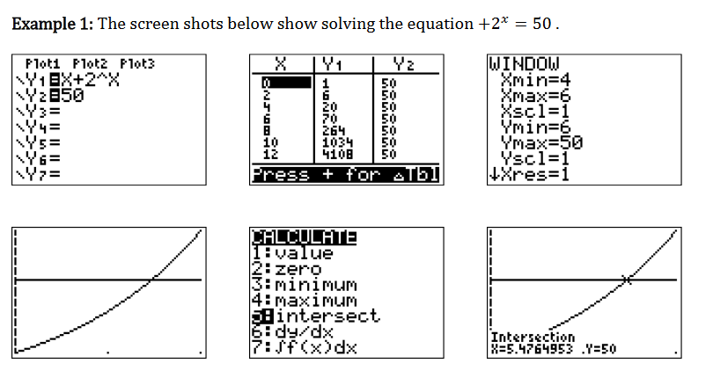
x

Slide 5
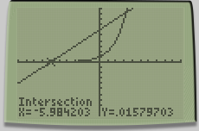
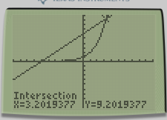
Solve the following: 2^{x} = 6 + x

Slide 8
Popper #10
Question 1:
Answers rounded to the nearest minute:
a. 75 minutes b. 17 minutes c. 125 minutes d. 100 minutes

Slide 9
Popper #10…continued
Question 2:
Answers rounded to the nearest percent:
a. 5% b. 10% c. 15% d. 20%

Slide 10
Optimization
Finding the optimal values of a function means to find the highest or lowest within a given range of values.
The easiest way to do this is using the calculator.
Once a function is plotted, select 2nd → CALC → Minimum
You will be prompted to enter the a starting x-value, stopping x-value and a guess (optional).

Slide 11
Find the maximum value (and where it occurs) of $f\left(x\right)=e^{−\frac{x^{2}}{2}}$

Slide 12

Determine the maximum and/or minimum of the following graph:
$$f\left(x\right)=\frac{1}{x^{2}+4}$$
$$g\left(x\right)=x^{2}−4x+5$$

Slide 13
A ball is thrown from the roof of a building. Its height, in feet, measured t seconds after being thrown is given by: h(t) = -16t² + 13t + 210.
Popper 11:
1. What is the height of the building?
a. 150 ft b. 200 ft c. 210 ft d. 250 ft
2. What is the maximum height of the ball?
a. 210 ft b. 212 ft c. 215 ft d. 220 ft
3. When will the ball reach its maximum height?
a. 0.4 sec b. 1.1 sec c. 1.4 sec d. 2.2 sec
4. When will the ball his the ground?
a. 3 sec b. 4 sec c. 5 sec d. 6 sec
5. Will the ball ever reach a height of 220 feet? a. Yes b. No

Slide 14
The sales a certain product, in thousands, t months after the beginning of a new product being marketed is given by: $p\left(t\right)=\sqrt{x^{3}−4x^{2}+2x+10}$
When will minimum sales occur within the first 5 months?
What will minimum sales be?
When will maximum sales occur within the first 5 months?
What will maximum sales be?

