Slide 1
MATH 1311
Section 3.1

Slide 2
The Geometry of Lines
Several applications involving lines can be see as most helpful when turned into geometric ideas. For example, this board lying against a brick wall.

Slide 3
Characterizing Straight Lines
If you are given two reference points, there is always a unique line that passes through them.
A line will always rise or fall at the same rate, regardless of where you are looking on the line.

Slide 4
X and Y intercepts of a line
The x-intercept of a line occurs when the line passes the x-axis (horizontal axis) and the y-intercept occurs when it passes the y-axis (vertical axis).
These are two convenient points to use for graphing a line.
Try to graph a line with an x-intercept of 4 and a y-intercept of -2.

Slide 5
Try to graph a line with an x-intercept of 4 and a y-intercept of -2.
Now, determine the y-value of the line at the x-value of 2.

Slide 6
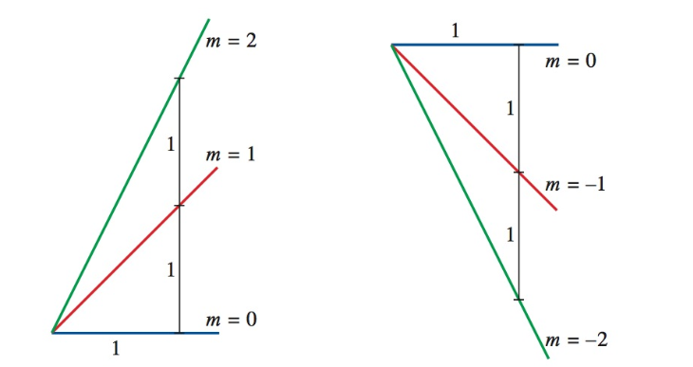
Slope of a line:
The slope of a line (represented by m) tells how fast the line is increasing or decreasing.

Slide 7
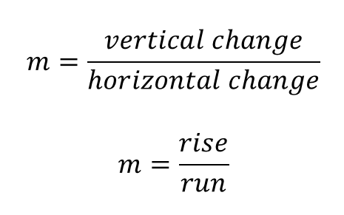
Finding the slope of a line:
The slope of a line is represented by the vertical change divided by the horizontal change.

Slide 9
Try This:
You are six feet tall and flying a kite that has an altitude of 20 feet, occurring 10 feet away from you (horizontal distance). You let out more string from the kite, at the same incline, so that it now is at a horizontal distance of 25 feet from you.
Determine the slope (or inclination) of the kite.
Determine the new altitude of the kite.

Slide 10
Popper #12
You are leaning a ladder against the side of a building. The ladder reaches up the building 40 feet and is resting on the ground 5 feet from the base of the building.
Determine the slope of the ladder.
a. 8 b. 0.625 c. 35 d. 45
If you are standing with your feet at a height of 15 feet, how far away from the building are you?
a. 25 ft b. 10 ft c. 1.875 ft d. 0.533 ft

Slide 11
Popper #12, continued
3. A line has an x-intercept of -3, and a y-intercept of 12. Determine its slope.
a. 0.25 b. 4 c. -4 d. -0.25
4. A line has an x-intercept of 2 and a slope of -1/4. Determine its y-value when x = 5.
a. 0.75 b. -0.75 c. -1.25 d. 1.25

