Slide 1
MATH 1311
Section 3.3

Slide 2
Modeling Data with Linear Functions
We have already seen how to create a linear function from two distinct data points. What we have not determined yet is how to identify if a collection of data points is, in fact, linear.
Remember, linear functions have a constant rate of change.

Slide 3
Test for Linearity:
To confirm the linearity of a set of data, you must determine the change in your independent and dependent variables. This change should be the same for every set of data points.

Slide 4
Galileo observed the following concerning the speed of an object falling versus its time spent falling:

Slide 5
Galileo observed the following concerning the speed of an object falling versus its time spent falling:
From this data, you can develop a new table which compares the change in t values versus the change in V values. What do you notice?

Slide 6
Create the equation of the linear function representing this data:

Slide 7
Another example:
Are the following tables linear or non-linear?
Data Set 1:
Data Set 2:

Slide 8
Another example:
Create an equation for the set of data that is linear.
Data Set 1:
Data Set 2:

Slide 9
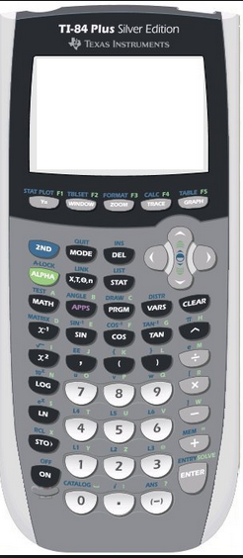
Calculator Applications:
Go to STAT, and select Edit.
This will allow you to input data into lists (Use L1 for one row of data and L2 for the other.)
Then press 2ND and Y= (STAT PLOT) to graph a scatter plot.

Slide 10
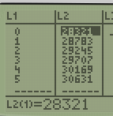
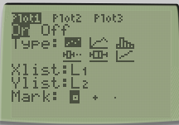
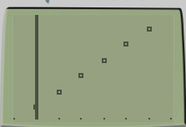
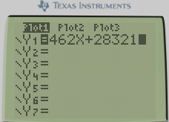
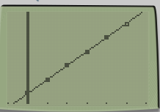
Input the data from the linear model we have used. Also input your equation in Y= and graph them together.
What do you notice?

Slide 11
Popper #15:
Does the table of data represent a linear function?
Yes, it is linear. b. No, it is non-linear
2. If it is linear, determine the slope of the line.
-4 b. 2 c. 0 d. Non-Linear
3. If it is linear, determine the y-intercept.
a. 2 b. 8 c. -4 d. Non-Linear

Slide 12
Popper #15…continued
4. Does the table of data represent a linear function?
Yes, it is linear. b. No, it is non-linear
5. If it is linear, determine the slope of the line.
1 b. 2 c. 3 d. Non-Linear
6. If it is linear, determine the y-intercept.
a. -6 b. 7 c. 0 d. Non-Linear

