Slide 1
MATH 1311
Section 3.4

Slide 2
Linear Regression:
When analyzing actual data, it very rare for the points to fall into a perfect straight line. Linear Regression is the process of finding the equation of a line that will “best fit” the presented data, even though it may not be a perfect match.
These are also called lines of best fit for this reason.

Slide 3
Try this:
Or the same table, where t is years from 2004:
Enter the t-values into L1 and the E-values into L2.

Slide 4
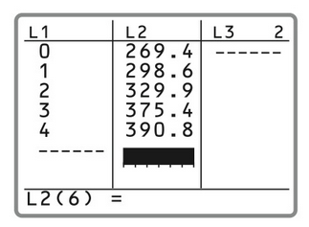
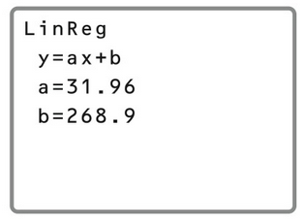
It should look like this:
becomes…..
Go to STAT and then scroll over to CALC.
Select LinReg (ax + b) (option 4)
As a default, it will use L1 as the x-values and L2 as the y-values.
Press ENTER.

Slide 5
What this means:
Based on the information presented to you in this screen, you can write the equation of the line of best fit for the data you have.
This is telling you that the Regression Line is y = ax + b,
where the a-value (slope) is 31.96, and the b-value
(y-intercept) is 268.9. So the equation of the line is
y = 31.96x + 268.9

Slide 6
How accurate is the regression line?
The Coefficient of Determination (the r-squared) value, tells the percent of the variation in the dependent variable that in explained by the regression.
Under the CATALOG menu, select DiagnosticsOn and find the regression line again.

Slide 7
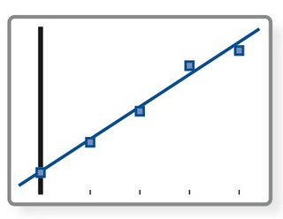
Take a look:
Graph the data points presented in the same window as the regression line.
You’ll notice that the points are not an exact match to the line, but they are close.
Actually, if you add up all the distances from the line, positive for above and negative for below, they will add up to zero!

Slide 8
Using a Regression Line:
Remember, our t-values were years from 2004. Using the regression line, estimate the expenditures for the year 2015.
Caution: Regression lines are most accurate close to the data you used to create them. The further away you go, the less accurate these lines are for estimation purposes.

Slide 9
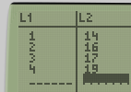
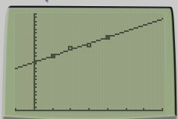
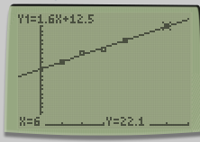
A child’s age in months and weight in pounds was recorded for four months (14, 16, 17, 19). Determine the line of best fit for this data, and estimate the child’s weight at 6 months.

Slide 10
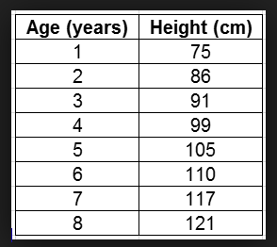
Popper 16:
Use the data from the table to create a regression line:
1. What is the slope of the regression line?
a. 84 b. 5 c. 6.42 d. 71.57
2. What is the y-intercept of the regression line?
a. 84 b. 5 c. 6.42 d. 71.57
3. Using the regression line, estimate the height of a child of age 10.
a. 200 b. 136 c. 150 d. 175
4. Using the regression line, estimate the height of a person of age 20.
a. 200 b. 136 c. 150 d. 175
5. Is a linear model good for long term estimation of height?
a. Yes b. No

