Slide 1
MATH 1311
Chapter 4 Wrap Up

Slide 2
MATH 1311….Section 4 Wrap Up (Since a lot of you were asking)

Slide 3
Radiation Exposure
According to the United Stated Environmental Protection Agency concerning radiation exposure decreases by a factor of 4 as distance doubles.
Meaning that as your distance from a radiation source doubles, your radiation exposure will be ¼ of the previous amount.
Assume your radiation exposure 1 mile from a nuclear event is measured at 400 rems.

Slide 4
Use this information to fill out the following table:
Distance (in miles) | Exposure (in rems)
1 | 400
2
4

Slide 5
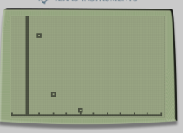
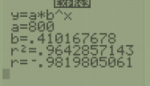
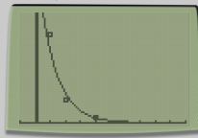
Use this table of data to create a exponential model of the radiation exposure.
Plot the scatter plot of this model.
Plot the graph of the exponential curve.
How accurate is this model to the data we have?

Slide 6
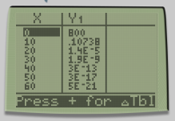
Using this model:
What was the initial radiation exposure of this event?
What will the exposure be at a distance of 10 miles?
What will the exposure be at a distance of 50 miles?

Slide 7
Rewrite this a logarithmic function:

Slide 8
Rewrite this a logarithmic function:
y = 800 (0.41017)^{x}
(y/800) = (0.41017)^{x}
log_{0.41017} (y/800) = x

Slide 9
Change of base formula:
To change a base within a logarithm: apply the following formula:
$$\log_{n}{a}=\frac{\log_{b}{a}}{\log_{b}{n}}$$
You can pick whatever b-value you want, typically e or 10 since those evaluate the easiest.

Slide 10
Write our function as a base e logartithm

Slide 11
Write our function as a base e logartithm
log_{0.41017} (y/800) = x
$$\frac{\ln{\frac{y}{800}}}{\ln{0.41017}}=x$$
$$\frac{\ln{\frac{y}{800}}}{−0.89118}=x$$

Slide 12
Convert back into exponential notation:
$$\frac{\ln{\frac{y}{800}}}{−0.89118}=x$$
ln (y/800) = -0.89118x
y/800 = e^{-0.89118x}
y = 800e^{-0.89118x}

Slide 13
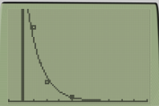
Graph this new function:
What do you notice?
Why did we convert into logarithms just to convert back to exponents?

Slide 14
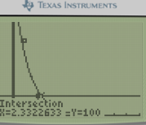
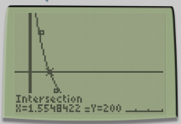
Radiation Exposure Effects
Based on your exponential curve, how far do you need to be to experience only slight blood changes?
How far must you be to experience no permanent injury?

Slide 15
Popper 26:
1. Can radiation exposure be modelled by exponential curves?
Yes b. No
2. Is radiation exposure a good thing?
Yes (I am hoping to develop superpowers)
No (I like having hair and teeth)

