Slide 1
MATH 1311
Section 4.4

Slide 2
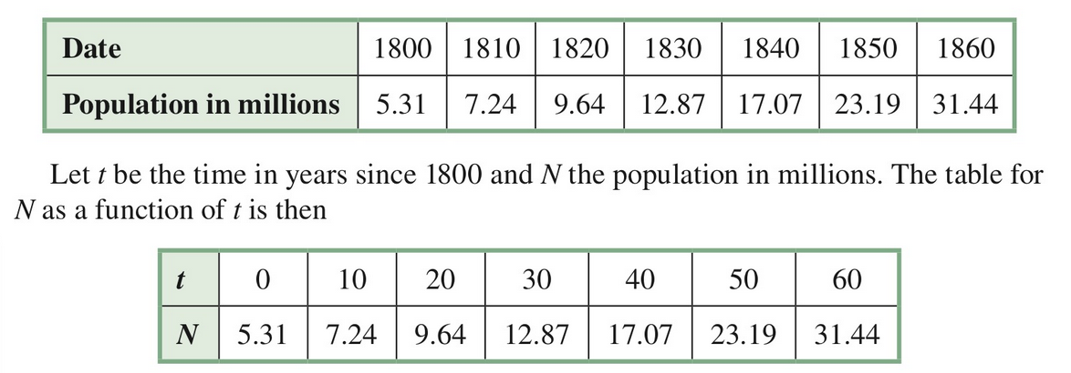
Modeling Nearly Exponential Data
In order to model data that is nearly exponential, you must use a method of regression similar to what was done with linear modelling.

Slide 3
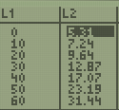
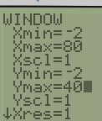
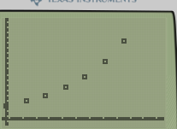
Entering into Stat Lists
Just like before, we can enter in to the STAT Lists, by pressing STAT, and Edit.
Enter your t-values into L1 and your N-values into L2.
Go into STATPLOT (2nd Y= ) in order to view the scatterplot (you may need to adjust your window to see all the points).

Slide 4
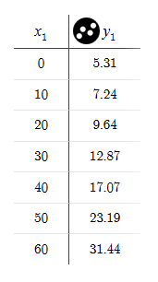
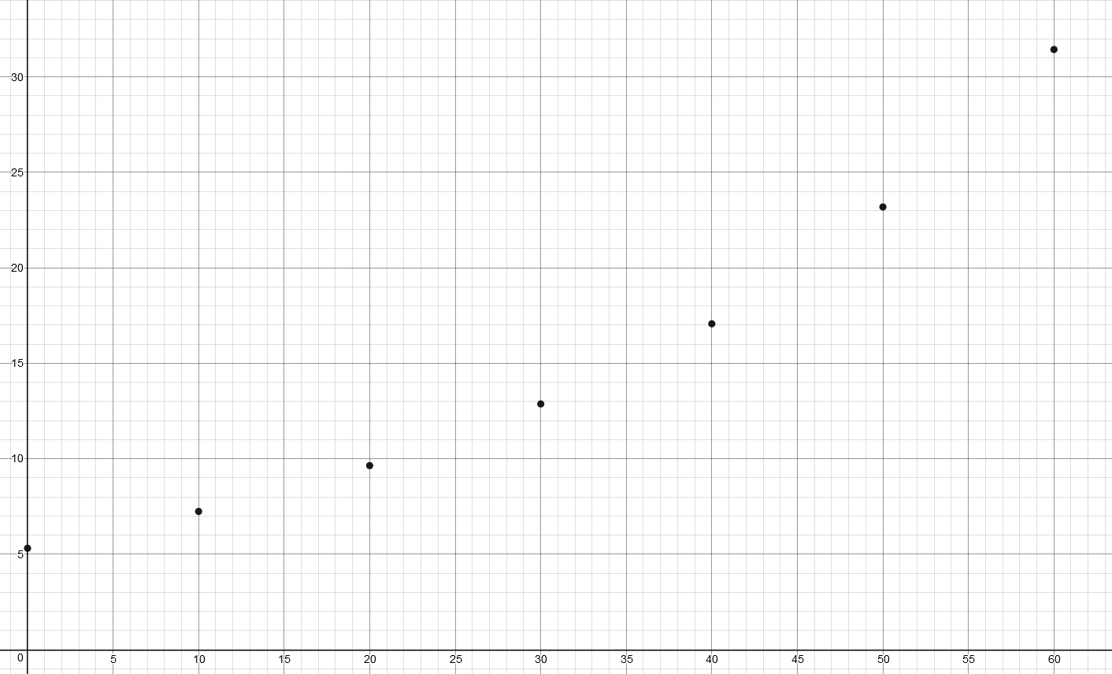
Table and Scatterplot

Slide 5
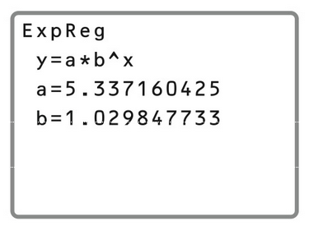
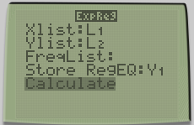
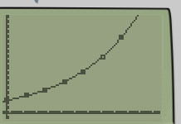
To Create an Exponential Model
Go to STAT, Calc, and select ExpReg and press ENTER.
This screen will tell you the generic form
of an exponential function, as well as the
values to substitute in for a (initial value)
and b (base number or growth factor).
y = 5.337 ^{x} 1.030^{x}

Slide 6
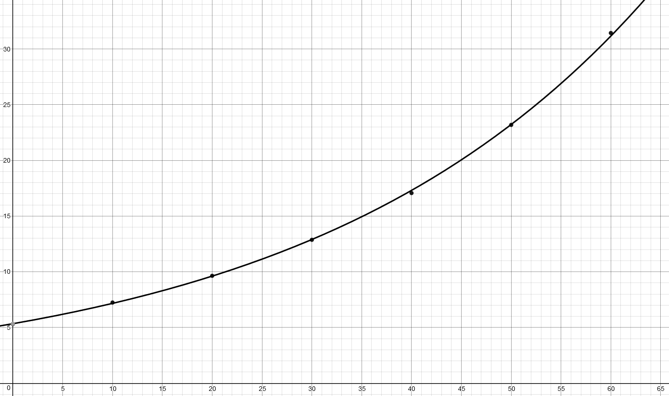
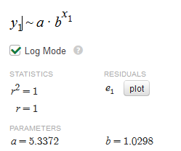

Slide 7
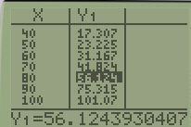
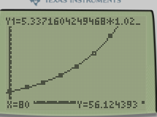
Using this information to extrapolate data.
If this trend continues, what would the expected population be for 1880 (t = 80)?

Slide 8
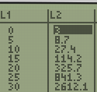
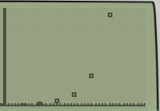
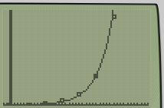
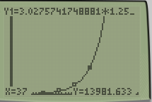
Try this one:
A study shows that the growth rate of a certain bacterial strain is given by the following table:
Plot a scatter plot of the data.
Does this appear to represent a exponential function?
Find the formula for the exponential function.
Graph this with the scatterplot.
Use this information to extrapolate the estimated bacterial count at 37 minutes.

Slide 9
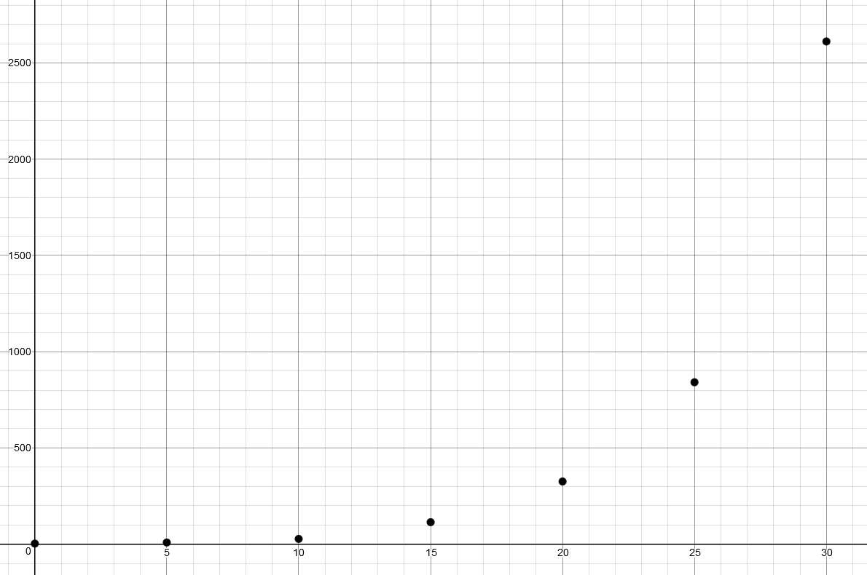
Scatter Plot

Slide 10
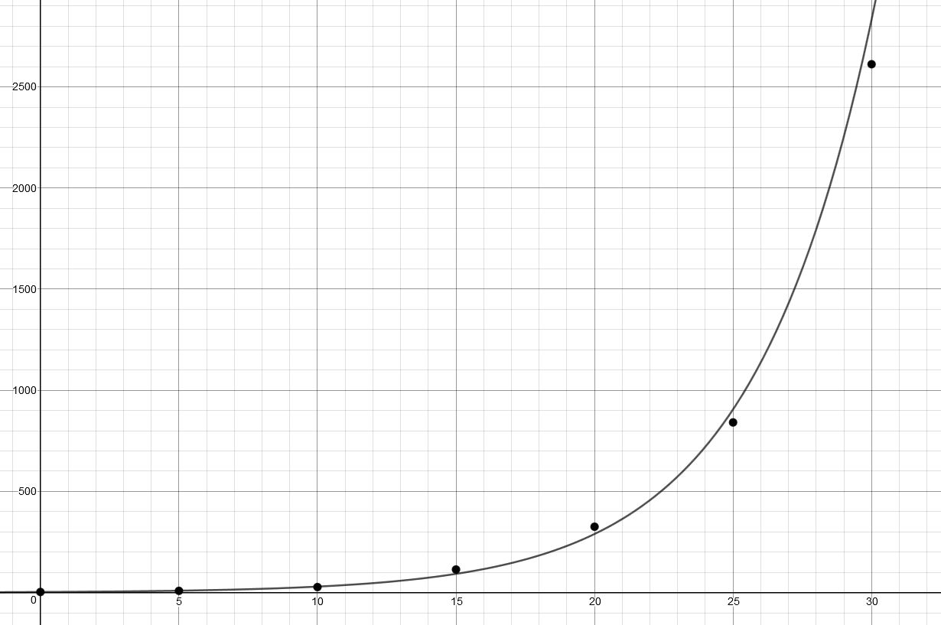
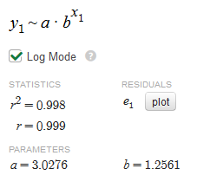
Exponential Regression:

Slide 11
Which model is the best?
How do you know if the best model for a certain set of data is linear or exponential?
If you have Diagnostics On in your calculator, you would see an r² value when you find a regression. This value tells you which model is the best for your data.
The closer the r² value is to 1, the better fit the data is.

Slide 12
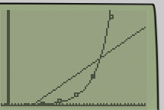
Try it out:
Using the same example of bacterial growth, find the r² value for exponential model.
Now, determine the formula for the linear model. (Remember, this will be LinReg.) What do you notice about the r² values?
Which model would be the better representation of the data?

Slide 13
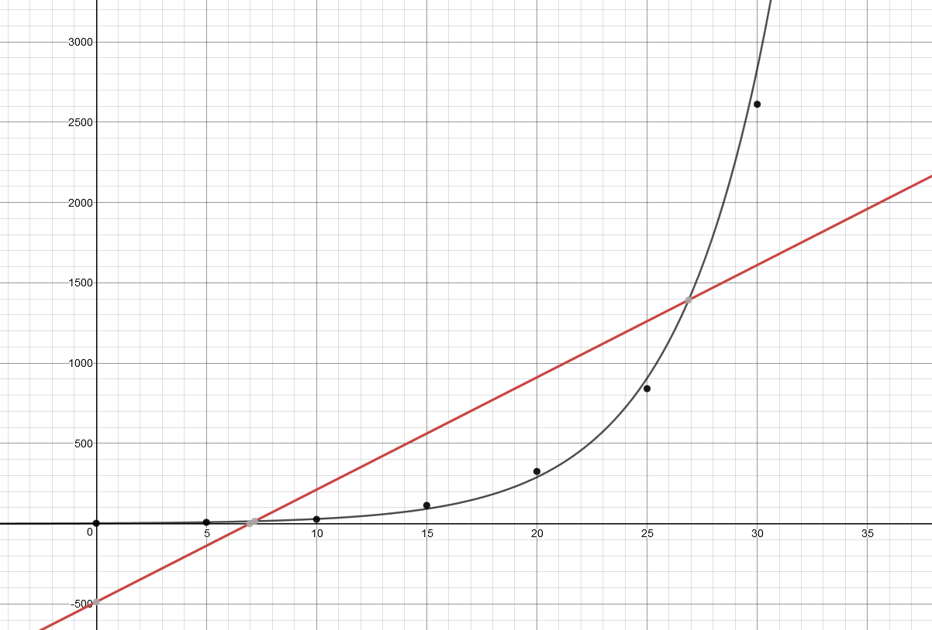
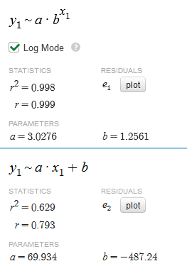
Comparison of Regression Models:
Linear Model
Exponential Model

Slide 14
What this all means?
The r² value explains how accurate the different model is. From the graphs, you can see the exponential model is much more accurate for this set of data.
The r² value explains this in more detail.
The exponential model is 99.8% accurate.
The linear model is 62.9% accurate.

Slide 15
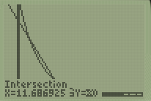
Popper 24:
The following table shows the amount of radiation exposure someone would receive being various distances away from a nuclear event.
Determine the linear model of this data.
a. y = 821.8x + 0.73 b. y = 0.73x + 821.8
c. y = -78.6x + 529.6 d. y = 529.6x – 78.6
2. Determine the percent accuracy of this model.
a. 97.5% b. 95% c. 99.1% d. 98.2%
3. Determine the exponential model of this data.
a. y = 821.8 ^{x} 0.73^{x} b. y = 0.73 ^{x} 821.8^{x}
c. y = -78.6 ^{x} 529.6^{x} d. y = 529.6 ^{x} 78.6^{-x}
4. Determine the percent accuracy of this model.
a. 97.5% b. 95% c. 99.1% d. 98.2%
5. Which model is more accurate?
a. Linear Model b. Exponential Model
6. Using the more accurate model, how far away from the event must you be to receive an exposure of less than 20 rads?
a. 11.7 miles b. 7.3 miles c. 979 miles d. 1.41 miles

