Slide 1
MATH 1311
Section 4.5

Slide 2
Logarithmic Functions
A logarithm is a function that is the inverse function of a exponential function. This means that it is the opposite function.
Anytime you are given a logarithm, you can translate it into an exponential:
$$\log_{n}{a=b}$$
can be rewritten as:
$$n^{b}=a$$

Slide 3
For example:
To evaluate:
$$\log_{10}{100}$$
you can turn it into a exponential function:
$$\log_{10}{100}=x$$
$${10}^{x}=100$$
and you can see that the answer would be 2.

Slide 4
The common logarithmic function:

Slide 5
Evaluate logarithms (with base 10).
LOG

Slide 6
Graph of y = log x

Slide 7
An example:
The number of flu virus in an enclosed space is set to increase by 10 times in the next 12 hours. Currently, there are 5000 active virus.
Write an exponential function to illustrate this:

Slide 8
An example:
The number of flu virus in an enclosed space is set to increase by 10 times in the next 12 hours. Currently, there are 5000 active virus.
Write an exponential function to illustrate this:
$$v\left(t\right)=5000∙{10}^{t/{12}}$$

Slide 9
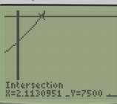
An example:
The number of flu virus in an enclosed space is set to increase by 10 times in the next 12 hours. Currently, there are 5000 active virus.
Write an exponential function to illustrate this:
$$v\left(t\right)=5000∙{10}^{t/{12}}$$
When can you predict that there will be 7500 active virus in the space?

Slide 10
An example:
When can you predict that there will be 7500 active virus in the space?
$$7500=5000∙{10}^{t/{12}}$$
$$1.5={10}^{t/{12}}$$
$$\log_{10}{1.5=\frac{t}{12}}$$
$${12∙log}_{10}{1.5=t}$$
$$t≈2.113$$

Slide 11
Solving for a logarithm:
To solve a logarithm, you can exponentiate the function. This means rewrite the function as exponents to the same base.
$$\log\left(x−1\right)=0.23$$
$${10}^{\log{(x−1)}}={10}^{0.23}$$
$$x−1={10}^{0.23}$$
$$x={1+10}^{0.23}≈2.698$$
unless otherwise written, log is base 10

Slide 12
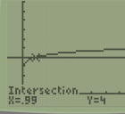
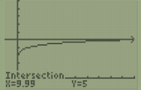
Example:
According to research the number of brain cells in a newborn increases at a logarithmic rate, given by the function:
$$b\left(t\right)=\log\left(t+0.01\right)+4$$
Where t is measured in years and b(t) is measured in billions of brain cells.
Determine the age at which the child will reach 4 billion brain cells.
Determine the age at which the child will reach 5 billion brain cells.

Slide 13
Natural Logarithms:
While common logarithms are always considered to be Base 10, Natural Logarithms are always considered to be Base e, for the irrational number e ≈ 2.71828…
$$\log_{10}{x}=\log{x}$$
$$\log_{e}{x}=\ln{x}$$
Note: All other base values, must be written out!

Slide 14
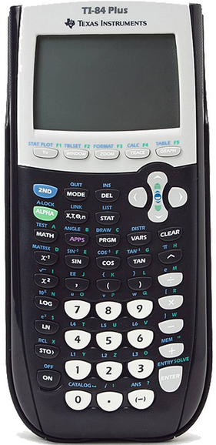
On the Calculator:
log (common base): LOG
ln(base e): LN
10^{x}: 2nd LOG
e^{x}: 2nd LN

Slide 15
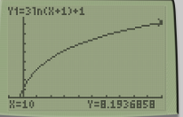
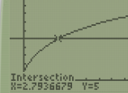
Popper 25:
The spread of a rumor in a school is modelled by the following equation:
$$r\left(t\right)=3\ln\left(t+1\right)+1$$
where t is measured in minutes and r(t) is number of people having heard the rumor.
What is the initial value?
a. 3 b. 1 c. 5 d. 0
2. How many people would have hear the rumor after 10 minutes?
3 people b. 5 people c. 8 people d. 10 people
3. How long will it take the rumor to be heard by 5 people?
a. 2.8 minutes b. 3.1 minutes c. 5.5 minutes d. 7.3 minutes

Slide 16
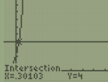
Popper 25…continued
The number of jellyfish in a portion of ocean water is increasing at a rate modelled by the formula:
$$j\left(t\right)=2∙{10}^{t}$$
where t is measured in minutes and j(t) is measured in number of jellyfish.
4. What is the initial value of the function?
a. 0 b. 1 c. 2 d. 10
5. How long will it take for the initial value to double?
a. 2 min b. 4 min c. 18 sec d. 25 sec

