Slide 1
MATH 1311
Section 5.1

Slide 2
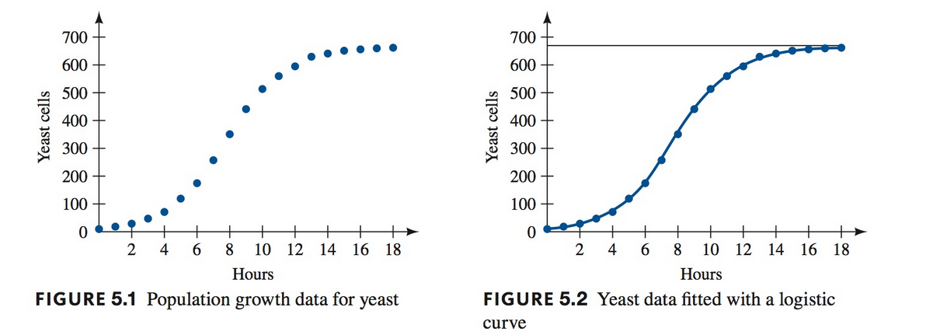
Logistic Functions
Logistical Functions are functions which level out to two different values. Often these are used to represent long-term population growth.

Slide 3
Key Features:
There is initial rapid growth:
The graph takes on the appearance of an exponential function for small x-values.
Point of Inflection:
The graph will change from concave up to concave down.
Leveling out:
The graph will level out to a different value than what it began at.

Slide 5
The Logistic Formula:

Slide 6
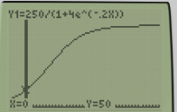
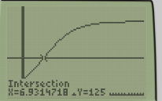
The number of plant buds in a flower pot is modelled by the logistic function, where t is measured in months: $$b\left(t\right)=\frac{250}{1+4e^{−.2t}}$$
How many buds are initially in the pot?
What will the carrying capacity be of this pot?
What would be the growth rate per month?
At what time will the monthly growth be the greatest?

Slide 7
You have a population with an initial value of 15 and a carrying capacity of 350. If the population grew without restrictions, it would be at a constant increase of 25% per year. Find the logistic curve.

Slide 8
Fitting Logistic Data to a model:
Just like before, after entering data into L1 and L2 (STAT → Edit), go to the STAT → Calc → LogisticReg and press ENTER.
Convert the Independent Variable to years from 1997.

Slide 9
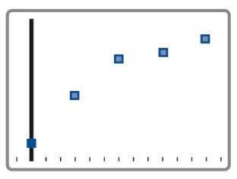
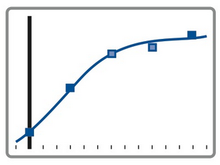
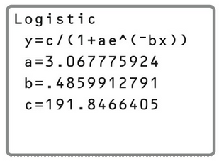
Data, Scatter Plot, Regression and Graph

Slide 10
Popper 27
The following table shows the population of a certain town from 1950.
What is the population of the town in 1950?
7 ppl b. 7000 ppl c. 70000 ppl d. 35000 ppl
2. Use Regression to find the equation of the Logistic Function:
a. $p\left(t\right)=\frac{35}{1+4e^{−.4t}}$ b. $p\left(t\right)=\frac{7}{1+5e^{−.2t}}$
c. $p\left(t\right)=\frac{35}{1+5e^{.4t}}$ d. $p\left(t\right)=\frac{−7}{1+e^{.4t}}$

Slide 11
3. What is the carrying capacity of the town?
a. 35000 ppl b. 35 ppl c. 7000 ppl d. 4000 ppl
4. When does the town obtain its largest growth rate?
3.5 years b. 17.5 years c. 35 years d. 50 years
5. What is the annual growth rate?
1.49 b. .49 c. .67 d. .33

