Slide 1
MATH 1311
Section 5.2

Slide 2
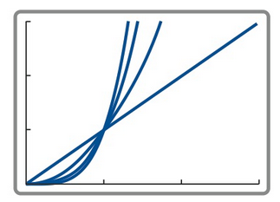
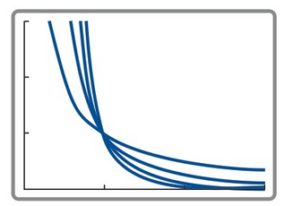
Power Functions
Power Functions are in the form of f(x) = cx^{k}, where c and k are constants. (Notice the difference between this and the exponential function where the variable is in the exponent.
k-value positive k-value negative

Slide 4
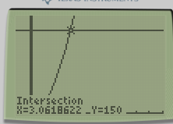
Example:
A falling object will travel D = 16t² feet in t seconds. If an object is dropped from a 150 foot building, how long will it take to reach the ground?

Slide 5
A cube has an edge measuring 2 inches. How will tripling the measure of the edge change the volume? (v = e³)

Slide 6
A cube has an edge measuring 2 inches. How will tripling the measure of the edge change the volume? (v = e³)
Original: v = 2³ = 8 8 cubic inches
New: v = (3^{x}2)³ = 6³ = 216 216 cubic units
Notice that there was an increase of 216/8 = 27 times.
The new volume is 27 times the original.
Also, note that 27 = 3³.

Slide 7
In a power function, the value of f(2) = 10 and the value of f(4) = 160. Find the equation of the power function.

Slide 8
In a power function, the value of f(2) = 10 and the value of f(4) = 160. Find the equation of the power function.
Note: Between these points, the x-value double, and the y-value increased by 16 times.
2 raised to what power is 16? Answer: 4, so your exponent is 4.
Then plug in either point to solve for the coefficient. 10 = a(2⁴), so a = 5/8.
So, the function is: f(x) = (5/8)x⁴

Slide 9
g(7) = 15 and g(21) = 405

Slide 10
Try This:
The ascent of a spaceship is modelled by a power function. After 4 seconds, the ship has an altitude of 12288 feet, and after an additional 4 seconds the altitude is 786432 feet. Determine the power function that will represent the height of the ship.

Slide 11
Popper 28
The daily energy consumption of hotel is given by a power function based on the hours after midnight. At 2:00 am, the hotel is using 96 kwh and by 6:00 am the hotel is using 2592 kwh.
By what factor did the time increase between these points?
no increase b. double c. triple d. quadruple
2. What is the ratio of kwh between these points?
3 b. 27 c. 2496 d. 2688
3. What is the exponent of the function?
a. 2 b. 3 c. 4 d. 5

Slide 12
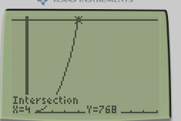
Popper 28 …continued.
4. What is the coefficient for this situation?
12 b. 96 c. 27 d. 3
5. What is the power function formula?
f(x) = 3x¹² b. f(x) = 27x³ c. f(x) = 12x³ d. f(x) = x¹²
6. What is the energy usage at 8:00 am?
512 b. 1728 c. 324 d. 6144
7. At that time will the energy usage be 768 kwh?
a. 4:00 am b. 5:00 am c. 6:00 am d. 7:00 am

