Slide 1
MATH 1311
Section 5.3

Slide 2
Modelling Data with Power Functions:
You can model power function data (or near power function data) by using the regression feature within the calculator.
As in previous examples, you can input your values using STAT → Edit and then L1 and L2. The command for power function regression is PwrReg.

Slide 3
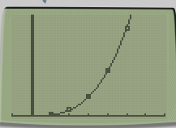
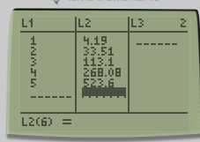
Example:
A balloon is inflated at a constant rate. Its radius and volume are recorded in the following table:
Create the power function that will best represent this data.

Slide 4
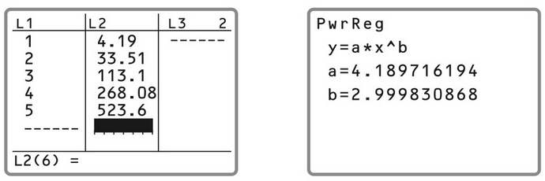
Example:
A balloon is inflated at a constant rate. Its radius and volume are recorded in the following table:
Create the power function that will best represent this data.

Slide 5
Comparison of Scatterplot and Graphs

Slide 6
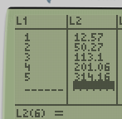
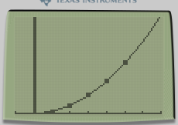
Repeat this process for the radius and surface area of the same balloon:

Slide 7
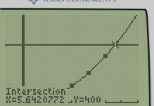
Repeat this process for the radius and surface area of the same balloon:
Based on the tensile strength of the rubber used to manufacture this balloon, it can stretch to a surface area of 400 square inches before popping. At what radius will that occur?

Slide 8
Kepler’s Third Law:
Kepler discovered that there was a relationship between the average distance a planet is from the sun and the amount of time it takes to complete one orbit. The following data shows these values for our solar system:
Create the power function for this data.

Slide 9
Kepler’s Third Law:
Kepler discovered that there was a relationship between the average distance a planet is from the sun and the amount of time it takes to complete one orbit. The following data shows these values for our solar system:
Kepler’s Third Law states that the average distance cubes divided by the period squared must be constant for each planet (d³/p²). Does your model confirm this?

Slide 10
Popper 29
The velocity of a projectile launched from the ground (during its ascent) is given by the following table:
Determine the power function for the projectile’s velocity.
a. v(t) = 350t⁻² b. v(t) = -350t² c. v(t) = t²/350 d. v(t) = 350t²
2. When will the projective slow to 0.01 mph (nearest 10 seconds)?
a. 100 seconds b. 150 seconds c. 190 seconds d. Never

