Slide 1
MATH 1311
Section 6.1

Slide 2
Velocity
Velocity is a vector measure. This means that is has components for magnitude (how fast) and direction (heading which way).
This means that you can estimate a velocity function from a directed distance function.
Positive Velocity means an object is moving up, away, or to the right.
Negative Velocity means the object is moving down, towards, or the left

Slide 3
Two graphs from a rock thrown into the air:

Slide 4
Key Characteristics of Velocity

Slide 5
Constant Velocity
If an object is considered to have a constant velocity (equal to a number), that means that the distance function is linear.

Slide 6
Example:
You leave home at 8:00 am and travel to school. It takes you 1 hour to arrive at school and you remain there for 5 hours. Then you travel back home (also taking 1 hour).
Sketch a graph to show your distance from home as a function of time.
Use this graph to create a graph of your velocity for that trip.

Slide 7
Example:
You leave home at 8:00 am and travel to school. It takes you 1 hour to arrive at school and you remain there for 5 hours. Then you travel back home (also taking 1 hour).
Sketch a graph to show your distance from home as a function of time.
Distance
8 9 10 11 12 1 2 3
Time

Slide 8
Example:
You leave home at 8:00 am and travel to school. It takes you 1 hour to arrive at school and you remain there for 5 hours. Then you travel back home (also taking 1 hour).
Sketch a graph to show your distance from home as a function of time.
Velocity
8 9 10 11 12 1 2 3
Time

Slide 9
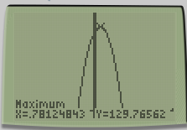
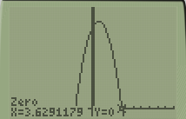
Distance given by a formula:
The height of a rock thrown from a building is given by
h(t) = -16t² + 25t + 120 where t is measured in seconds and h is measured in feet.
Sketch this graph (using the calculator) and determine the t-values where the maximum height occur and where the rock hits the ground.
Use this to estimate the graph of the rock’s velocity.

Slide 10
Distance given by a formula:
The height of a rock thrown from a building is given by
h(t) = -16t² + 25t + 120 where t is measured in seconds and h is measured in feet.
Sketch this graph (using the calculator) and determine the t-values where the maximum height occur and where the rock hits the ground.
Use this to estimate the graph of the rock’s velocity.
The actual velocity formula is: v(t) = -32t + 25. Graph this as well. How does this function compare to your estimate of the rock’s velocity?

Slide 11
You leave home at 9:00 am and travel for thirty minutes. Then you realize that you left the oven on, so you return home at the same speed. You then travel for 1 hour to your destination, where you stay 3 hours before returning home again.
Which graph would best represent your distance graph for this situation?
Which graph would best represent your velocity graph for this situation?
Choices on the next slide.

Slide 12
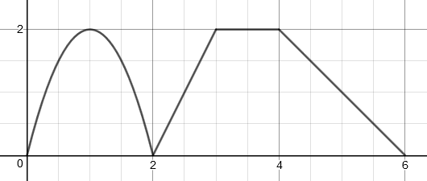
A
B
C
D

