Slide 1
MATH 1311
Exam 1 Review
Part I (Test 1): 12 Multiple Choice Questions, Worth 78 Points
Part II (Test 1 FR): 2 Written Response Questions, Worth 22 points

Slide 2
Round the Decimal to the nearest hundredth.
23.877
0.933
11.4355543
4.999

Slide 3
*An apartment complex charges $950 per month as rent, with an additional $50 for every tenant.
Write a formula for the amount of income the apartment complex plans to earn in a month, in terms of n (the number of apartments rented) and t (the number of tenants in the apartments).

Slide 4
*Continued…..
Use this function to calculate the income the apartment complex will earn for renting 35 apartments to a total of 112 residents.

Slide 5
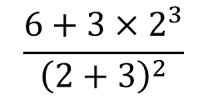
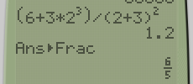
Evaluate the following:

Slide 6
Write the following in scientific notation:
0.00000532
342,000,000

Slide 7
Popper 04
Fill out answer choice C for Questions 1 – 5

Slide 8
*Review the following table of values, and answer the associated questions.
Determine the Average Rate of Change of R(t) from t = 20 to t = 30.

Slide 9
*Continued……
Use the AROC to estimate the value of R(25).
Use the AROC to estimate the value of R(22).

Slide 10
The formula for the population of a certain species is given by: Where a is the carrying capacity of the environment, b is the starting population, r is the doubling coefficient, and t is number of years.
Determine the population for a = 5, b = 3, r = 2, and t = 0.5
What is the average rate of change from t = 1 to t = 2 with the same conditions (a, b, r) above.

Slide 11
You have a friend in Europe that is asking to know your height. Since you know he will be using the metric system, you want to give your height in centimeters.
Convert : 5ft 8in into centimeters (1 in is approximately 2.54 cm).

Slide 12
Your friend says his height is 197 cm. How much is this in inches and feet?

Slide 13
You are monitoring your weight. At the start of your diet/exercise program, your weight was 170 pounds. In the first month, you lost 12% of your total weight. The following month, you gained 4% of your current weight. What is your weight at the end of the second month?

Slide 14
A phone plan charges $150 per month for two accounts. Each additional account is $15 extra. Determine the equation for calculating the monthly bill (assuming you are putting more than 2 people on your plan).

Slide 15
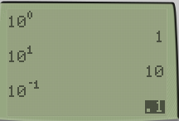
Evaluate the following:

Slide 16
A function is increasing at an increasing rate, what is its concavity?

Slide 17
A function is given by f(t) = 8 + 5e^{-3t}
Determine the initial value.
Determine the value at t = 2, and at t = 4.
Does the function have a limiting value? If so, what is it?

Slide 18
Popper 05
Questions 1 – 5….Bubble in choice B

