Slide 1
MATH 1311
Test 2 Review
10 multiple choice questions (Test 2): 80 points
2 free response questions (Test 2 FR): 20 points

Slide 2
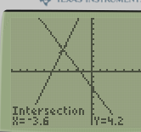
Solve the equation: 5(x + 3) – 2x = -x – (x + 3)

Slide 3
Solve the equation for x: 5xy + 8x – 6y = 10x + 8x – 7xy + 2

Slide 4
Solve the equation for c: ab + 3ac – 4c = c + 5

Slide 5
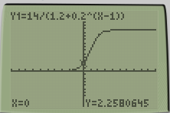
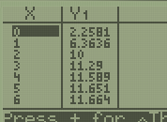
The number of people in a certain city is given by the equation, where x is measured in years and P(x) is measured in millions of people. $$P\left(x\right)=\frac{14}{1.2+{0.2}^{x−1}}$$
Find the initial value of the equation, and interpret its meaning.

Slide 6
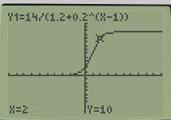
The number of people in a certain city is given by the equation, where x is measured in years and P(x) is measured in millions of people. $$P\left(x\right)=\frac{14}{1.2+{0.2}^{x−1}}$$
What is the population after 2 years?

Slide 7
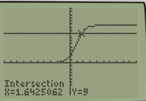
The number of people in a certain city is given by the equation, where x is measured in years and P(x) is measured in millions of people. $$P\left(x\right)=\frac{14}{1.2+{0.2}^{x−1}}$$
When will the population reach 9 million people?

Slide 8
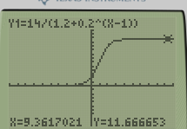
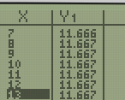
The number of people in a certain city is given by the equation, where x is measured in years and P(x) is measured in millions of people. $$P\left(x\right)=\frac{14}{1.2+{0.2}^{x−1}}$$
Will the population ever level out? If so, to what value?

Slide 9
A stone is thrown upwards from the top of a building at an initial speed of 35 mph. Its height is given by the formula: h(t) = -16t² + 35t + 120 where t is measured in seconds after being thrown and h(t) is measured in feet.
What is the height of the building?

Slide 10
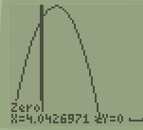
A stone is thrown upwards from the top of a building at an initial speed of 35 mph. Its height is given by the formula: h(t) = -16t² + 35t + 120 where t is measured in seconds after being thrown and h(t) is measured in feet.
When will the stone reach the ground?

Slide 11
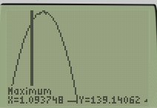
A stone is thrown upwards from the top of a building at an initial speed of 35 mph. Its height is given by the formula: h(t) = -16t² + 35t + 120 where t is measured in seconds after being thrown and h(t) is measured in feet.
What is the maximum height of the stone? When will this happen?

Slide 12
Popper 19
Fill out Answer Choice C for Questions 1 – 5

Slide 13
The following table relates variables x and y:
*
Is this a linear relationship?

Slide 14
The following table relates variables x and y:
*
What is the slope of the line?

Slide 15
The following table relates variables x and y:
*
What is the y-intercept of the line?

Slide 16
The following table relates variables x and y:
*
What is the equation of the line?

Slide 17
The following table relates variables x and y:
*
Use this equation to estimate the y-value that corresponds to an x-value of 5.

Slide 18
Based on the near-linear data, determine the equation of the linear model that most closely matches the data:

Slide 19
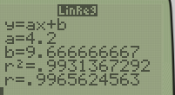
Based on the near-linear data, determine the equation of the linear model that most closely matches the data:
How accurate (as a percent) is this linear model?

Slide 20
Based on the near-linear data, determine the equation of the linear model that most closely matches the data:
Use the linear model to find the value of p in the following coordinate point: (7, p)

Slide 21
The pitch of a roof has a slope of 1.5. If the peak of the roof is 12 feet higher than the walls, and located in the exact center of the house, how wide is the house?

Slide 22
A parking lot charges $7 for a car and $10 for a bus to park for the day. The lot sold 30 parking tickets for the day and earned $234.
Write an equation for the number of vehicles parked.

Slide 23
A parking lot charges $7 for a car and $10 for a bus to park for the day. The lot sold 30 parking tickets for the day and earned $234.
Solve this equation for c.

Slide 24
A parking lot charges $7 for a car and $10 for a bus to park for the day. The lot sold 30 parking tickets for the day and earned $234.
Write an equation for the revenue of parking those vehicles.

Slide 25
A parking lot charges $7 for a car and $10 for a bus to park for the day. The lot sold 30 parking tickets for the day and earned $234.
Solve this equation for c.

Slide 26
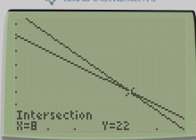
A parking lot charges $7 for a car and $10 for a bus to park for the day. The lot sold 30 parking tickets for the day and earned $234.
Solve the system (using a graphing calculator).

Slide 27
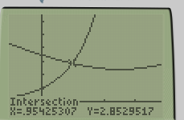
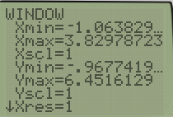
Using the crossing method, solve the following equation: $$\sqrt{x^{2}−5x+12}=3^{x}$$
*
Provide a sketch of both graphs (label your axis with a scale and label your intersection point).

Slide 28
A linear equation has the values of g(-3) = 5 and g(2) = 15. Determine the equation of the linear function, and use it to find g(10).
*

Slide 29
Popper 20
Questions 1 – 5, bubble in Answers Choice A.

