Slide 1
MATH 1311
Test 3 Review
12 Questions: All Multiple Choice
Additional Popper 33: Answer A for #1 – 10

Slide 2
Bacteria in a petri dish have an initial number of 45 colonies and are multiplying from there. Sketch a possible graph of their population growth.

Slide 3
Bacteria in a petri dish have an initial number of 45 colonies and are multiplying from there. Sketch a possible graph of their population growth. If the population will double in 5 hours, determine the formula for hourly population growth.

Slide 4
The number of trees in a forest is declining by 7% every year. The current population of the forest is 3575 trees.
Write an exponential function to model this situation.

Slide 5
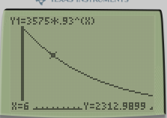
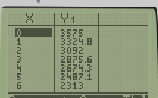
The number of trees in a forest is declining by 7% every year. The current population of the forest is 3575 trees.
Determine the population of the forest in 6 years.

Slide 6
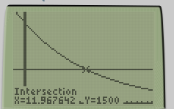
The number of trees in a forest is declining by 7% every year. The current population of the forest is 3575 trees.
Determine when the population will reach 1500 trees.

Slide 7
Popper 32
Answer Choice D for #1 – 5

Slide 8
The formula for the weight of a toddler is given by: w(t) = 35(1.15)^{t} where t is measured in months.
What is the monthly growth rate of the child? (give as a percent increase or percent decrease)

Slide 9
The high temperature in the month of December decreases by 2% every day. By what percent of the original will it decrease by the 20th of the month?

Slide 10
Identify the following tables of values as linear, exponential or neither. Find an equation if linear or exponential.

Slide 11
The following table shows the number of alligators in a nature preserve.
Rescale the table so that x = 0 corresponds to 2005 and find the exponential regression of the table.

Slide 12
The following table shows the number of alligators in a nature preserve.
What year will the population reach 2000 alligators?

Slide 13
The Richter scale is used for comparing the magnitudes of earthquakes. An increase of t on the Richter scale means an increase of 10^{t} in the magnitude of the earthquake.
Two earthquakes register a 3.5 and a 6.1 on the Richter scale. Compare their magnitudes.

Slide 14
How does the volume of a cube change if its edge decreases by 12%.
Formulas to know: Volume of a cube: V = e³
Volume of a sphere: V = ⁴/₃ πr³
Area of a rectangle: A = L W
Area of a triangle: A = ½ B H

Slide 15
Given the following logistic growth model:
$$N\left(t\right)=\frac{250}{1+be^{−0.255t}}$$
If the initial value is N(0) = 40, determine the value of b.
What is the carrying capacity of the function?
Determine the coordinates of the point of inflection of the function.

Slide 16
Determine the composite function f(g(x)) if:
f(x) = 2x + 8 and g(x) = e^{x}
Use this to determine the value of f(g(2)).

Slide 17
A certain quantity increases by 12% every day. What is the daily growth factor? What is the weekly growth factor? What is the monthly (30 day) growth factor?

