Slide 1
MATH 1314
Final Exam Review

Slide 3
fitpoly(L,3)
f(2010-2003)

Slide 5
limit(f(x),-2)

Slide 6
limit(f(x),infinity)

Slide 8
f'(x)
f‘’(x)

Slide 9
tangent(1,f(x))

Slide 10
h'(3)

Slide 11
intersect(C(x),R(x))

Slide 12
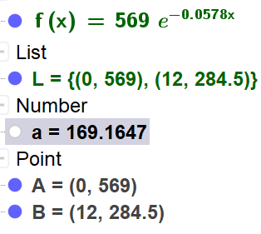
fitexp(L)
f(21)

Slide 13
simplify(P(x))
f'(x)
f'(200)

Slide 14
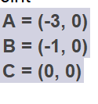
root(f'(x))
f(-3)
f(-1)

Slide 15
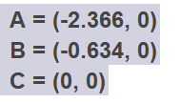
root(f''(x))
f(-2.366)
f(-.634)
f(0)

Slide 16
RectangleSum(f(x), 1, 9, 6, 0.5)
UpperSum(f(x), -2, 2, 50)

Slide 17
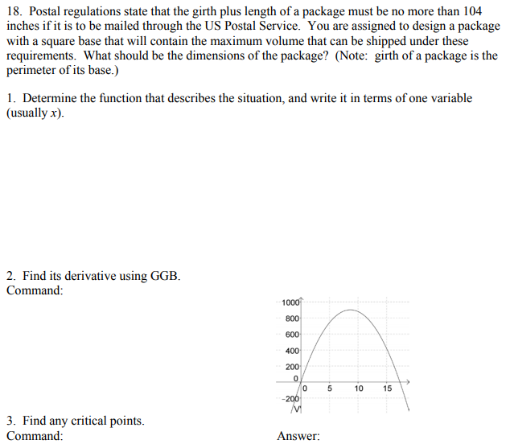
v'(x)
104-4*17.3333
root(v'(x))

Slide 19
Integral(f(x), 1.3, 1.5)

Slide 20
Integral(f(t), 0, 5)

Slide 21
1/(7-0)*Integral(C(t), 0, 7)

Slide 22
IntegralBetween(0, f(x), -3, 5)

Slide 23
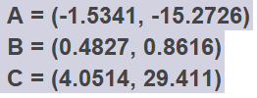
Intersect(f(x), g(x))
IntegralBetween(f, g, -1.5341, 0.4827)+IntegralBetween(g, f, 0.4827, 4.0514)

Slide 24
Intersect(D(x), 8)
Integral(D(x), 0, 13.75)-8*13.75

Slide 25
f(1,1)
fx=Derivative(f, x)
fy=Derivative(f, y)
fxx=derivative(fx,x)
fxy=derivative(fx,y)
fyy=derivative(fy,y)

Slide 27
Intersect(fx=0, fy=0)
d(x,y)=fxx*fyy-(fxy)^2

Slide 28
