Slide 1
MATH 1314
Lesson 1: Prerequisites

Slide 2
Identifying Polynomials
To begin with, let’s review the definition of a polynomial function.
A polynomial is the sum and/or difference of terms that contain variables and/or real constants, with variables raised to whole number (0, 1, 2, 3, …) powers.

Slide 3
Example 1: Which of the following are polynomial functions?

Slide 4
Domain:
The domain of a function is the set of all values of the independent variable(s) for which a function is defined, i.e. yields real-valued results.

Slide 5
Example 2: Find the domain of each of the following functions.

Slide 6
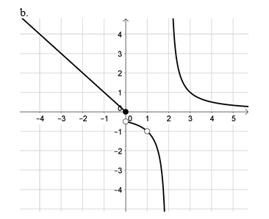
Example 3: Given the graph of a function below, give the domain.

Slide 7
Multiplying, Solving and Evaluating Functions

Slide 8
Example 5: Find the roots of each function below.

Slide 9
Example 6: Find f(-2) for each function below, if possible.

Slide 10
Example 7:

Slide 12
Analyzing Graphs of Polynomials

Slide 17
Piecewise Defined Functions
A function that is defined by two (or more) equations over a specified domain is called a piecewise function.

Slide 20
Now you can take Practice Test 1 (up to 20 times) then take Test 1 (up to 2 times) from anywhere online (no CASA reservation needed).

