Slide 1
MATH 1314
Lesson 10: Elasticity of Demand

Slide 2
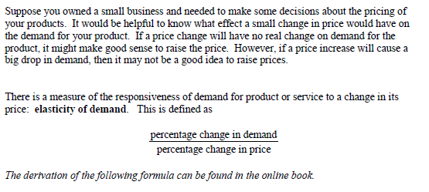

Slide 4
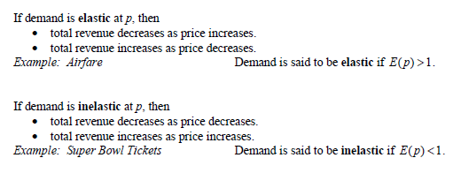
Revenue Response To Elasticity

Slide 5
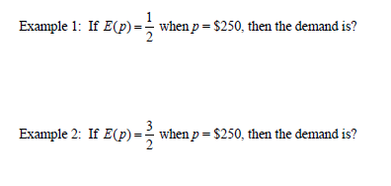

Slide 6
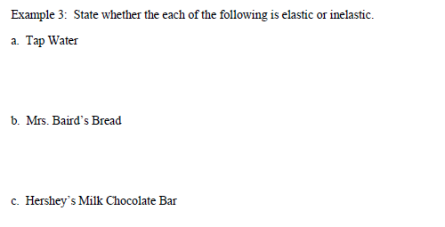

Slide 7
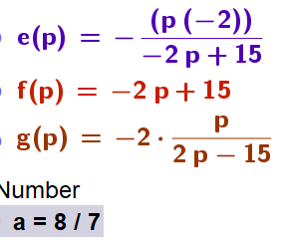
e(p)=-p*f’(p)/f(p)
simplify(e(p))
e(4)
Elastic: decreasing the price would increase revenue

Slide 8
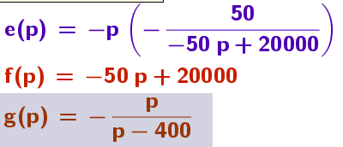
Note: The demand function must be solved for x, in terms of p.

Slide 9
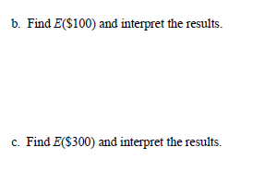

Slide 10
Popper 9:
For the following, consider a product with the demand function of:
x = f(p) = 1000 – 5p
Find f’(p)
995p b. -5 c. -5p d. 1000p
2. Set up the elasticity function:
a. 5p/(1000-5p) b. -5p/(1000-5p) c. 5/(1000-5p)
3. Simplify the elasticity function
a. p/(1000-p) b. 1/200 c. p/(200-p) d. p/195

Slide 11
Popper 9 Continued:
4. Evaluate the elasticity function at p = 50
2 b. 0.5 c. 0.333 d. 3
5. Determine elasticity at p = 50
demand is elastic b. demand is inelastic
6. Interpret results for p = 50
An increase in price will decrease demand
An increase in price will increase demand
An increase in price will not affect demand

