Slide 1
MATH 1314
Lesson 11: Exponential Functions

Slide 2
Exponential Functions:

Slide 3
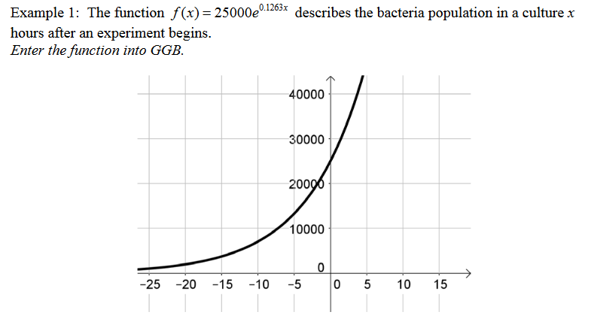
f(0)

Slide 4
f(10)

Slide 5
f’(20)

Slide 6
Solve(f(x)=35000)

Slide 7
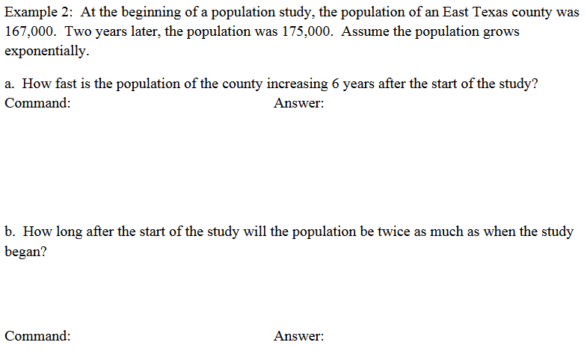
Fitexp(L)
f'(6)
solve(f(x)=2*167)

Slide 8
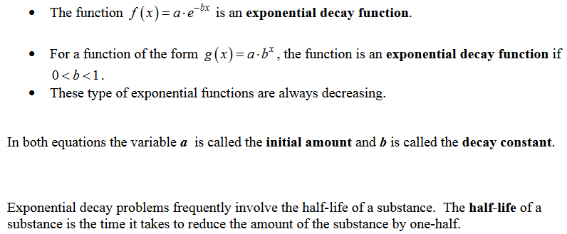
Exponential Decay

Slide 9
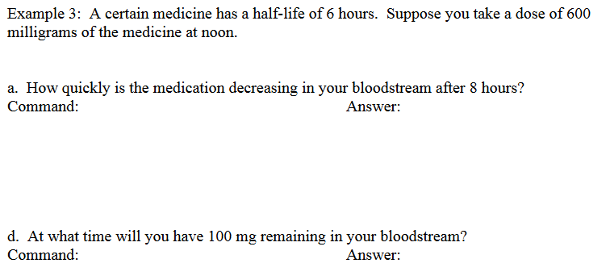
f'(8)
Solve(f(x)=100)
15.5
Intersect(f(x),100)

Slide 10
Popper 10:
Consider the following exponential function: f(x) = 35 2.3^{x}
Is this an exponential growth or decay function?
a. Growth b. Decay
2. What is the initial value?
3. What is the growth/decay constant?
a. 2.3 b. 35 c. 80.5 d. 37.3

Slide 11
Popper 10, continued:
4. What is the value of f(5)?
5. What is the value of f(10)?
144993 b. 2071 c. 2253 d. 18024
6. Changing which value will turn this into a decay curve:
Negating the initial value
Changing the initial value to less than 1
Negating the growth constant
Changing the growth constant to less than 1

Slide 12
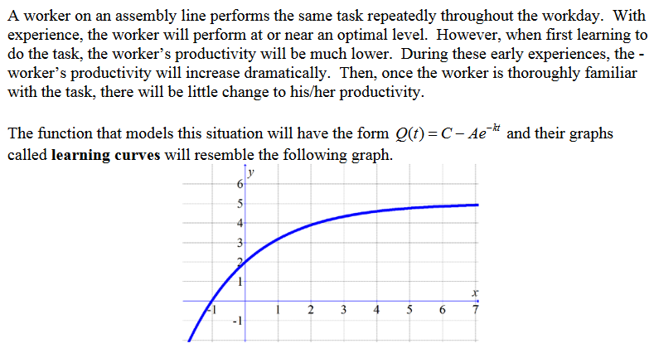
Limited Growth Models

Slide 13
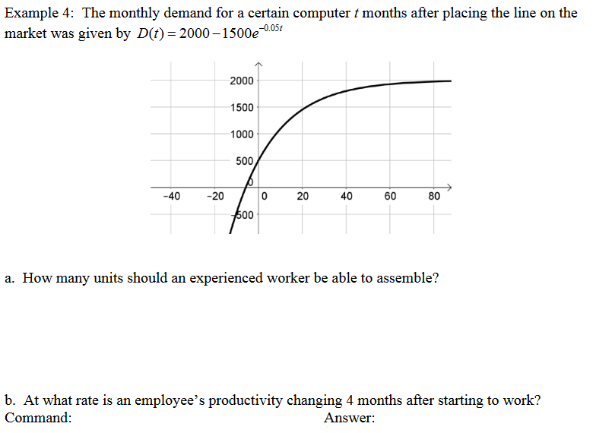
limit(d(t),infinity)
d’(4)

Slide 14
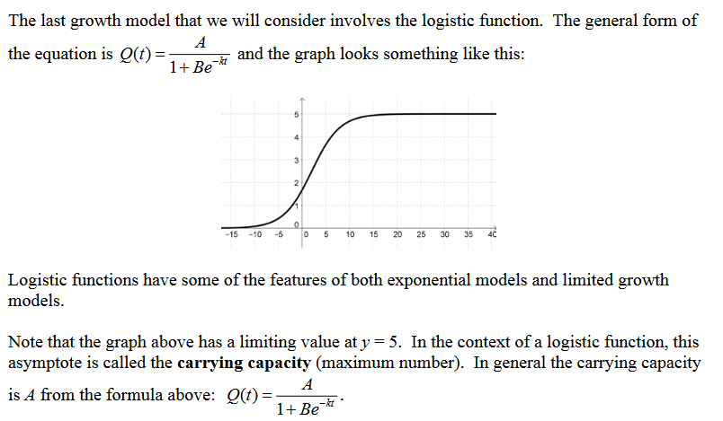
Logistic Functions

Slide 16
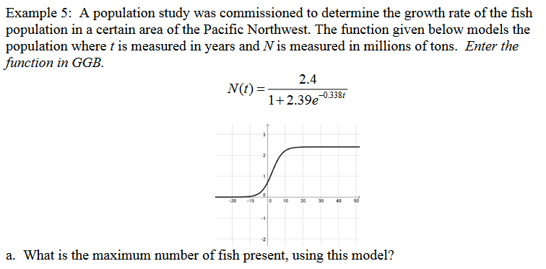
limit(n(t),infinity)

Slide 17
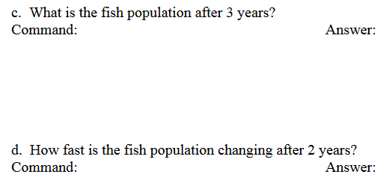
n(3)
n'(2)

Slide 18
Popper 11:
Consider the following logistic function:
$$f\left(x\right)=\frac{5}{1+{5∙3}^{−1.3x}}$$
What is the initial value of this function?
What is the value when x = 1?
What is the maximum value?
4. When x = 3, how fast in the graph changing?
5 b. 0.431 c. 0.833 d. 2.274
5. When does the graph have a turning point?
a. x = 3 b. x = 0 c. x = 4 d. Never

