Slide 1
MATH 1314
Lesson 12: Curve Analysis (Polynomial)
To solve Friday’s mystery:
f(x) = 1234e^(0.1234x)
intersect(f(x),100.0)
This will give you the decimal answer.
New Window afterwards so you don’t overload and get kicked out afterwards.

Slide 2
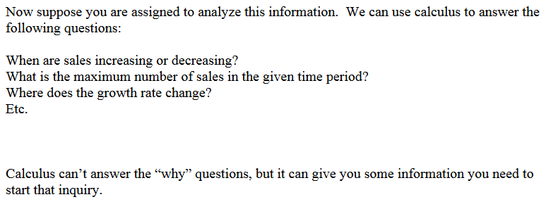

Slide 3
Intervals on Which a Function is Increasing/Decreasing

Slide 5
root(f'(x))

Slide 11
Popper 12:

Slide 12
Concavity and Points of Inflection

Slide 15
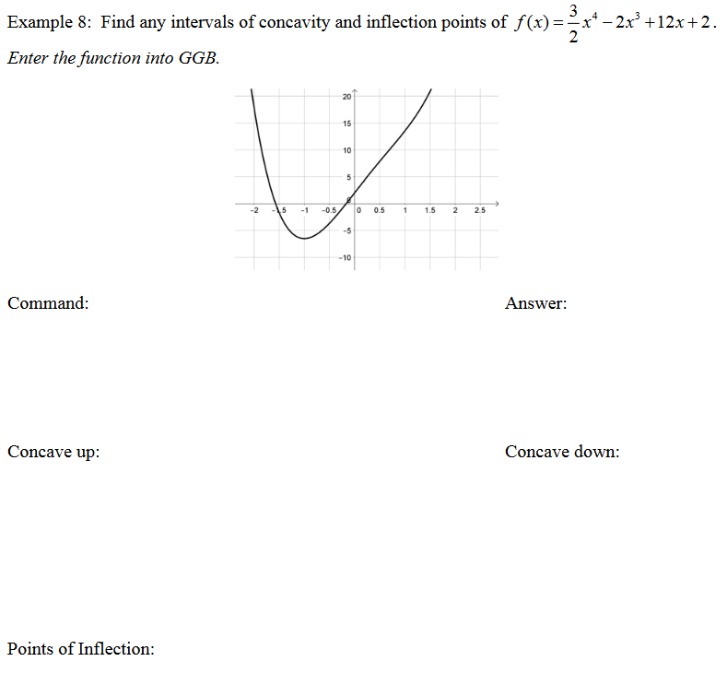
InflectionPoint(f(x))

Slide 21
Summary:
If you are given f’(x):
increasing: positive decreasing: negative
concave up: increasing concave down: decreasing
If you are given f”(x):
concave up: positive concave down: negative

