Slide 1
math 1314
Lesson 13: Analyzing Other Types of Functions

Slide 2
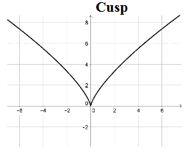
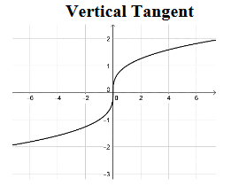
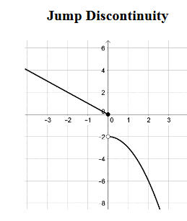
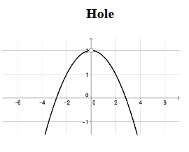
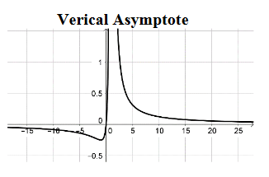
Critical Numbers versus Critical Points

Slide 3
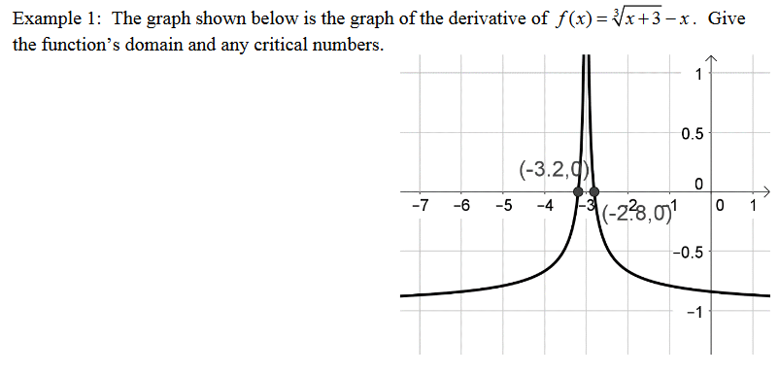

Slide 4
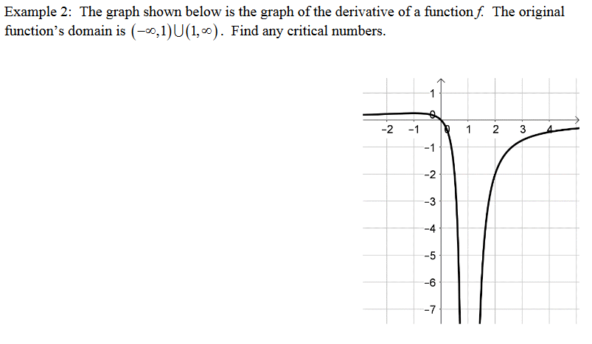

Slide 5
Geogebra Command Reminders:

Slide 8
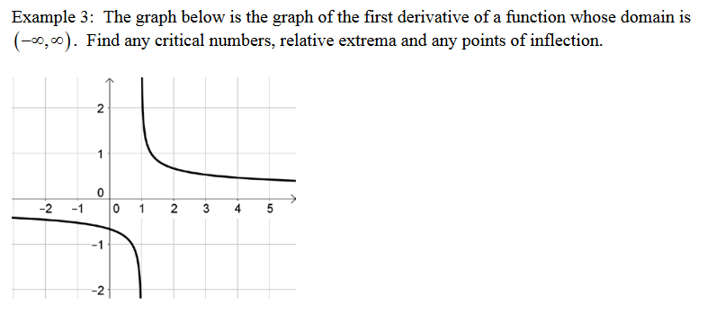

Slide 9
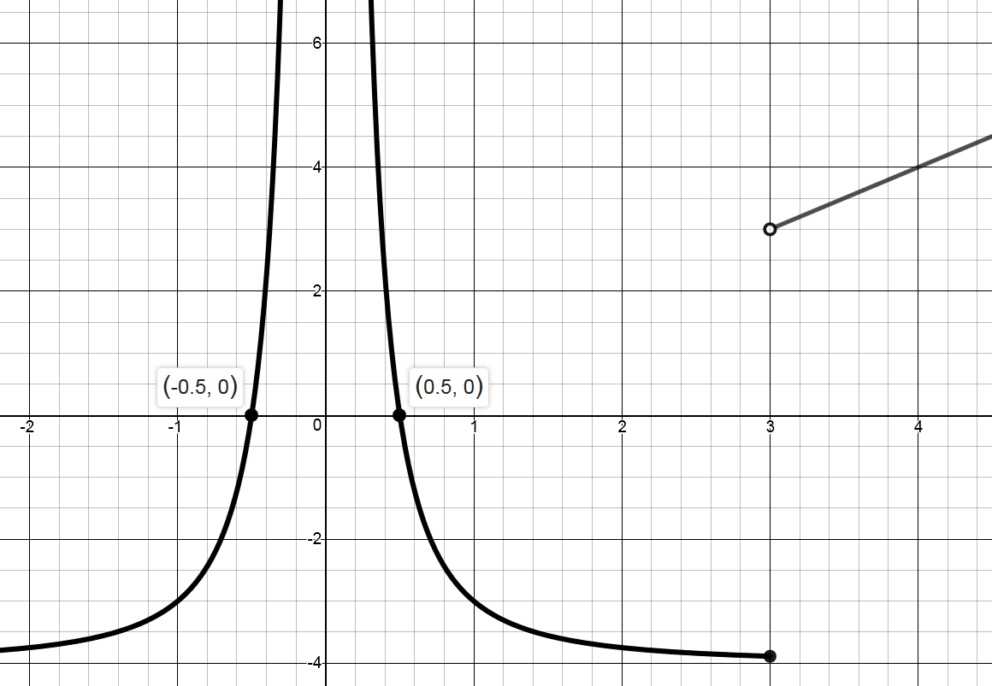
Popper 14:
The graph illustrated is f’(x), the first derivative of some function f(x). f(x) is defined on (-∞, 0) ∪ (0, ∞).
Determine the critical values for f(x).
a. 0 b. -0.5 c. 0.5 d. 3 e. All of these
2. Where is one interval that f(x) is increasing?
a. (-∞,-0.5) b. (0.5, 3) c. (0, 0.5) d. (0.5, ∞)
3. Determine the location of relative maximum:
a. x = -0.5 b. x = 0 c. x = 0.5 d. x = 3 e. No Rel Max
4. Where is one interval where f”(x) is positive?
a. (0, 3) b. (- ∞, 0) c. (3, ∞) d. (0, 0.5)
5. Where is one interval where f(x) is concave down?
a. (0, 3) b. (- ∞, 0) c. (3, ∞) d. (0, 3)
6. Determine the location of a point of inflection.
a. x = 3 b. x = 0 c. x = 0.5 d. No points of inflection

Slide 10
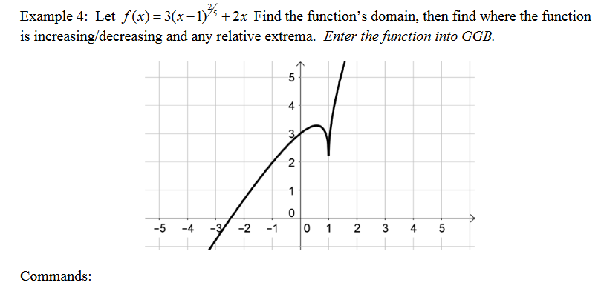

Slide 11
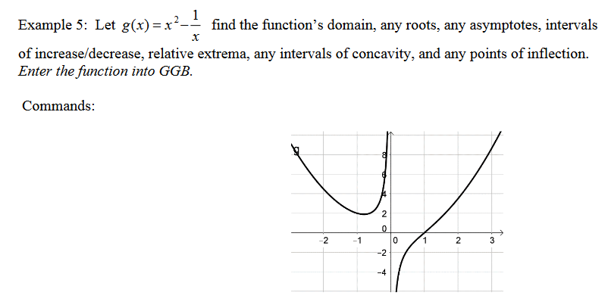
Continued on Next Slide

Slide 12
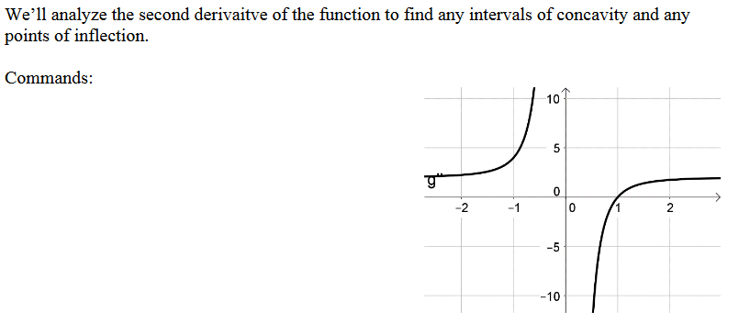

Slide 14
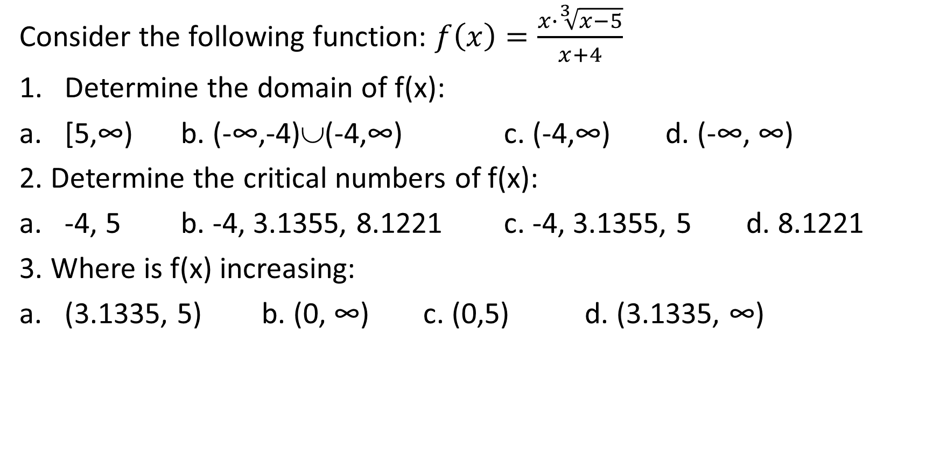
Popper 15:
Consider the following function: $f\left(x\right)=\frac{x∙\sqrt[3]{x−5}}{x+4}$
Determine the domain of f(x):
[5,∞) b. (-∞,-4)∪(-4,∞) c. (-4,∞) d. (-∞, ∞)
2. Determine the critical numbers of f(x):
-4, 5 b. -4, 3.1355, 8.1221 c. -4, 3.1355, 5 d. 8.1221
3. Where is f(x) increasing:
(3.1335, 5) b. (0, ∞) c. (0,5) d. (3.1335, ∞)

Slide 15
Popper 15:
4. Determine the location of a relative maximum:
a. 3.1335 b. -4 c. 5 d. No Relative Minimum
5. Where is f(x) concave up?
(-∞, -4) b. (-4, 5) c. (5, ∞) d. Never
6. Where is the location of an inflection point?
a. x = -4 b. x = 5 c. x = -4 & 5 d. No Inflection Points

