Slide 1
MATH 1314
Lesson 15: Second Derivative Test and Optimization

Slide 6
Extremum(c(x), 25, 75)

Slide 7
Popper 17
Consider the graph of $f\left(x\right)=10e^{−.2x}\sqrt{.2x}$ which models the sales an item x months after it has been first marketed.
Find all critical values: Roots(f'(x))
0 b. 2.5 c. 5 d. both (a) and (b) e. None of these
2. What is the value of f”(x) at the critical value?
f”(x) < 0 b. f”(x) > 0 c. f”(x) = 0
3. Classify the critical value in terms of f(x).
Relative Minimum b. Relative Maximum c. Neither

Slide 8
Popper 17 continued:
4. What is the maximum value?
2.5 b. -0.3431 c. 4.2888 d. 0
5. Determine the intervals where f(x) is increasing and decreasing:
inc: (0, 2.5); dec: (2.5, ∞) b. inc: (2.5, ∞); dec: (0, 2.5)
c. always increasing d. always decreasing
6. Is the extremum we found an absolute extremum?
a. Yes b. No

Slide 11
extremum(a(x))

Slide 12
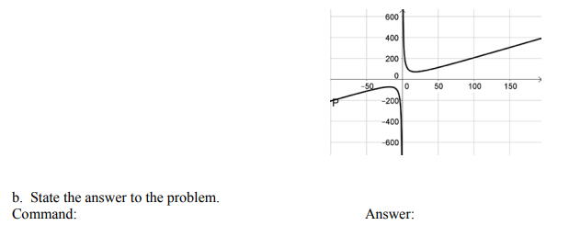

Slide 13
extremum(c(x),10,50)

Slide 14
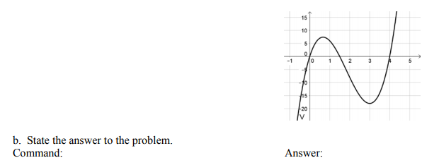
extremum(v(x))

Slide 15
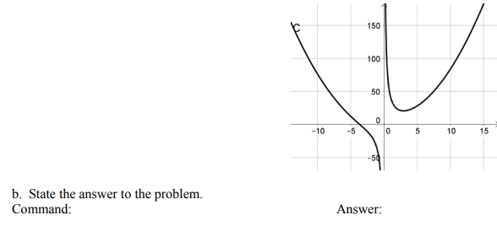

Slide 16
Extremum(c(x), 2, 4)

Slide 17
extremum(a(x),0,20)

Slide 18
Popper 18:
Two numbers have a difference of 25. Find their minimum product.
Assuming the smaller number is x, what is the larger?
25x b. x – 25 c. 25 – x d. x + 25
2. Write a formula for their product.
p = x² + 25x b. p = 2x + 50 c. p = x² + 25 d. p = 25x
3. Find the derivative of the product function:
a. p’ = 2x b. p’ = 2x + 25 c. p’ = 27x d. p’ = 25

Slide 19
Popper 18, continued.
4. Determine the critical values.
23 b. 12.5 c. 0 d. 50
5. Determine the second derivative of the product function:
p” = 25x b. p” = 2x c. p” = 2 d. p” = 2x + 25
6. Is the critical value a minimum or maximum?
a. It is a minimum b. It is a maximum

