Slide 1
MATH 1314
Lesson 16 and 17
Area and Riemann Sums

Slide 2
Approximating Area

Slide 9
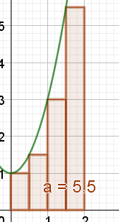
RectangleSum(f(x), 0, 2, 4, 0)

Slide 10
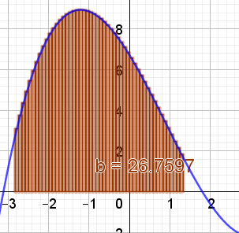
RectangleSum(f(x), -2.82, 1.33, 50, .5)

Slide 11
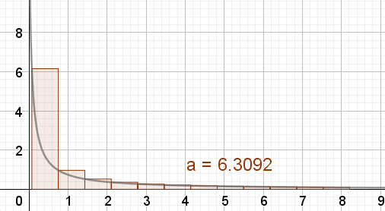
RectangleSum(f(x), 0.075, 8.21, 12, 0)

Slide 12
Upper and Lower Sums GeoGebra

Slide 13
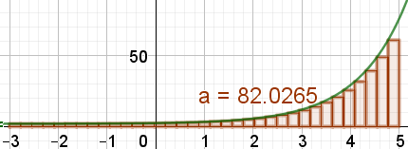
UpperSum(f(x), -3, 5, 35)
LowerSum(f(x), -3, 5, 35)

Slide 15
Popper 20:
How would read the following integral? $\int_{−2}^{5}{{(x+1)}^{2}dx}$
The slope of the tangent line between x= -2 and x = 5
The rate of increase between x = -2 and x = 5
The area between the graph and the x-axis from x = -2 to x = 5
The arc length of the graph between x = -2 and x = 5
2. Calculate the approximate area using 5 left corner rectangles.
3. Calculate the approximate area using 5 right corner rectangles.
4. Calculate the upper sum of 5 rectangles.
5. Calculate the lower sum of 5 rectangles.
a. 72.33 b. 99.12 c. 100.30 d. 50.12 e. 48.72

Slide 16
Popper 20….last question:
6. How you would change this method to be calculate an exact area?
Use midpoint rectangles.
Average all the approximations together
Double the number of rectangles.
Increase the number of rectangles to be a limit at infinity.

