Slide 1
MATH 1314
Lesson 18
Finding Definite and Indefinite Integrals

Slide 2
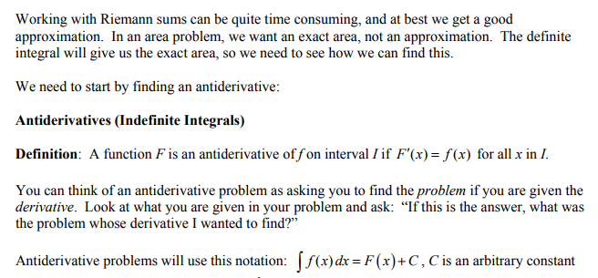

Slide 4
Geogebra Commands
integral(f(x))
CAUTION: this command will not give the +C at the end of the integration. You must add that yourself!

Slide 5
Popper 21:
The reverse of a derivative is the:
antiderivative b. integral c. indefinite integral d. all of these
2. When taking an indefinite integral, a constant should always be added at the end. a. Always b. Sometimes c. Never
The derivative of a function is f’(x) = 6x – 3. The function could be:
a. 3x² – 3x + 5 b. 3x² – 3x + 2 c. 3x² – 3x d. All are possible

Slide 6
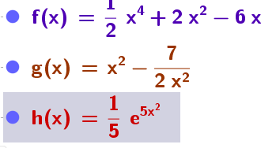
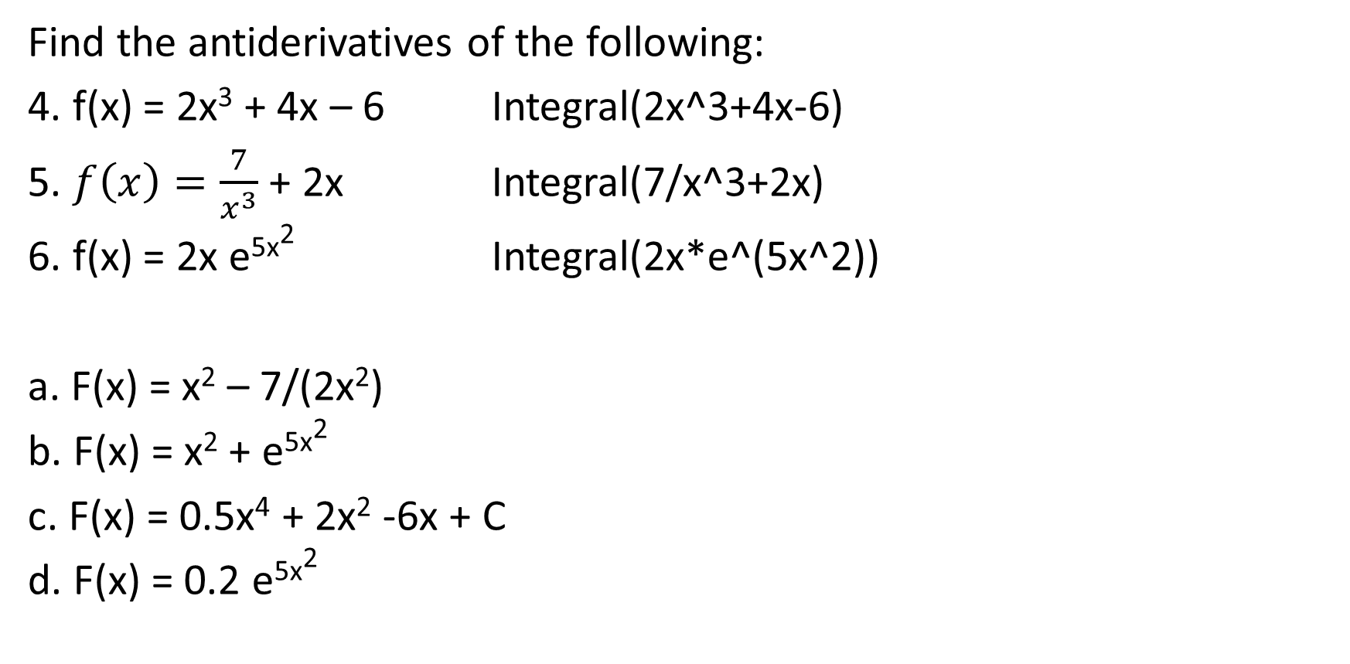
Popper 21…continued
Find the antiderivatives of the following:
4. f(x) = 2x³ + 4x – 6 Integral(2x^3+4x-6)
5. $f\left(x\right)=\frac{7}{x^{3}}$ + 2x Integral(7/x^3+2x)
6. f(x) = 2x e^{5x2} Integral(2x*e^(5x^2))
a. F(x) = x² – 7/(2x²)
b. F(x) = x² + e^{5x2}
c. F(x) = 0.5x⁴ + 2x² -6x + C
d. F(x) = 0.2 e^{5x2}

Slide 7
Basic Rules

Slide 8
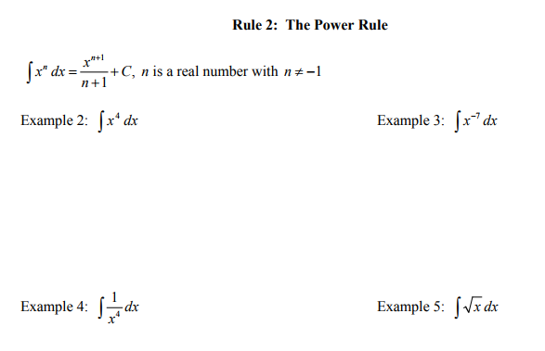

Slide 11
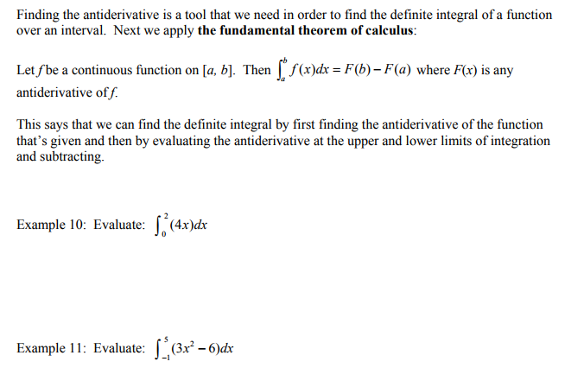

Slide 12
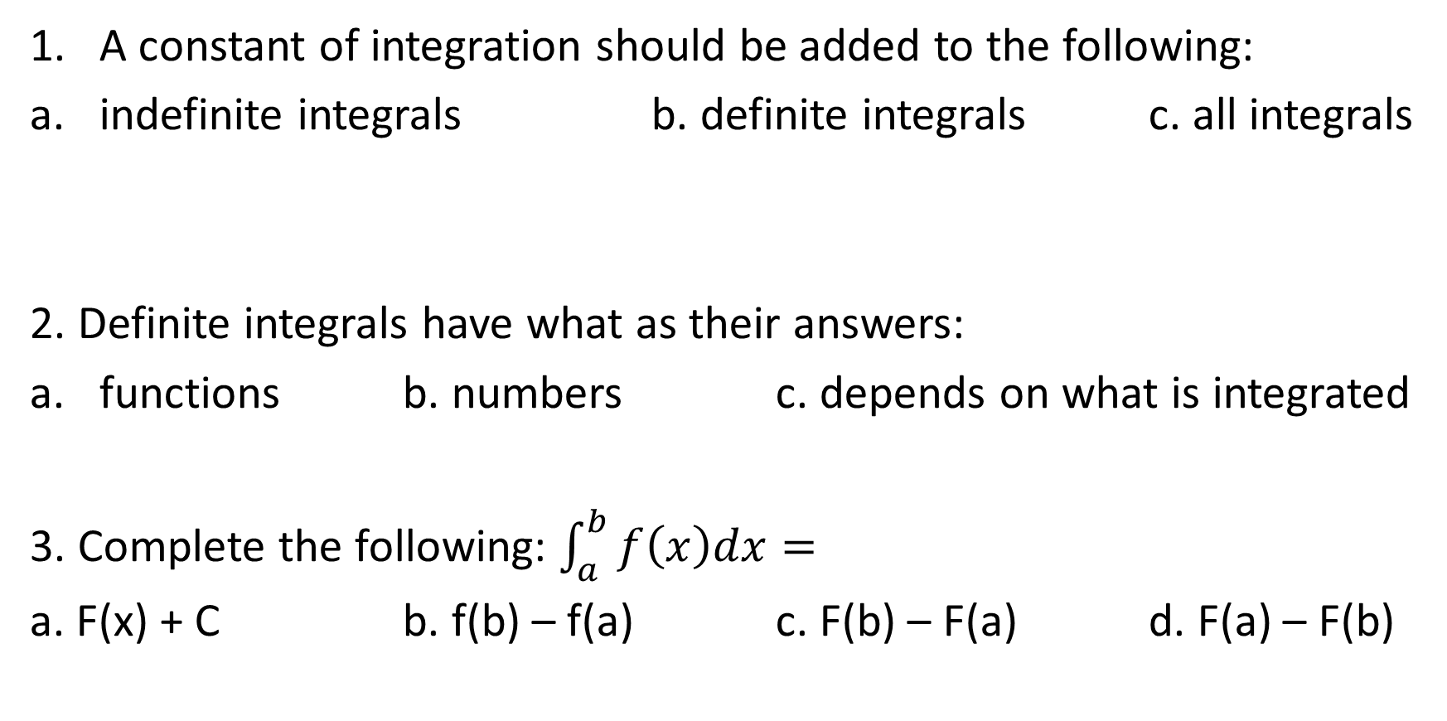
Popper 22:
A constant of integration should be added to the following:
indefinite integrals b. definite integrals c. all integrals
2. Definite integrals have what as their answers:
functions b. numbers c. depends on what is integrated
3. Complete the following: $\int_{a}^{b}{f\left(x\right)dx=}$
a. F(x) + C b. f(b) – f(a) c. F(b) – F(a) d. F(a) – F(b)

Slide 13
Popper 22…continued
Determine the following integrals:
4. $\int{\left[4x^{2}+5x+3\right]dx}$
5. $\int{25πdx}$
6. $\int_{0}^{2}{\left[x^{2}+3x\right]dx}$
a. 25πx + C
b. (4/3)x³ + (5/2)x² + 3x + C
c. 12.5π² + C
d. 8.667

