Slide 1
MATH 1314
Lesson 19
Numerical Integration

Slide 2
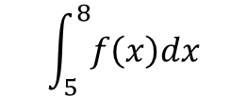
Evaluating Definite Integrals on Geogebra
$$\int_{5}^{8}{f\left(x\right)dx}$$
will become: integral[f(x),5,8]

Slide 3
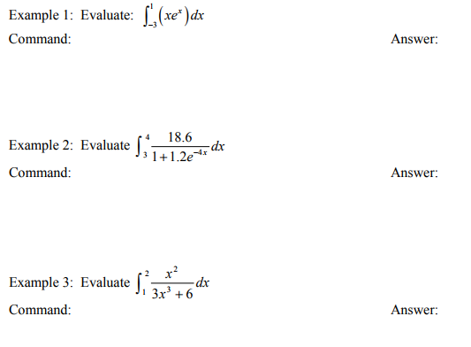
Begin each problem by entering the function into GGB.
Integral(f(x), -3, 1)
Integral(f(x), 3,4)
Integral(f(x), 1,2)

Slide 5
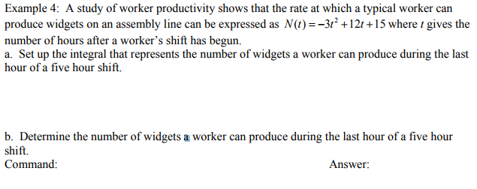
integral(N(t),4,5)

Slide 6
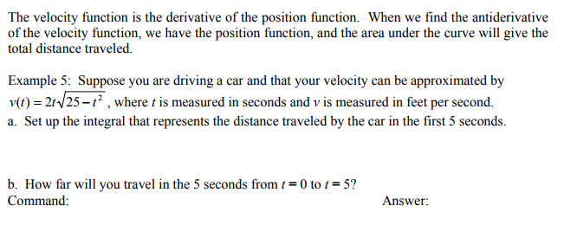
integral(v(t),0,5)

Slide 8
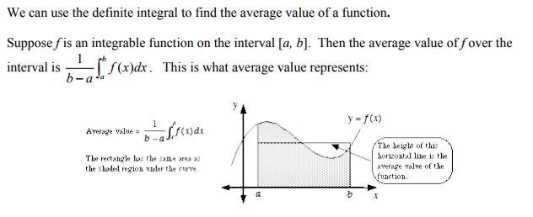
The Average Value of a Function

Slide 9
1/3*Integral(f(x), 2, 5)

Slide 10
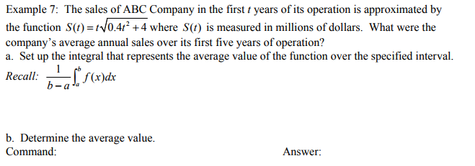
1/5*Integral(s(t), 0, 5)

Slide 11
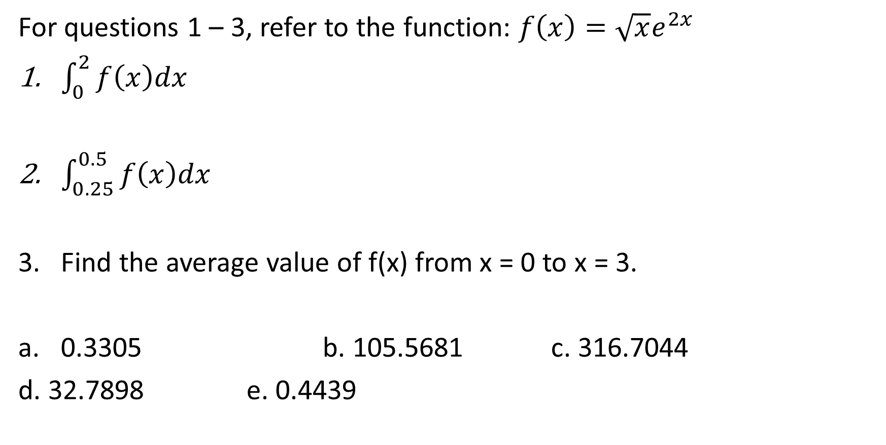
Popper 23
For questions 1 – 3, refer to the function: $f\left(x\right)=\sqrt{x}e^{2x}$
$\int_{0}^{2}{f\left(x\right)dx}$
$\int_{0.25}^{0.5}{f\left(x\right)dx}$
Find the average value of f(x) from x = 0 to x = 3.
0.3305 b. 105.5681 c. 316.7044
d. 32.7898 e. 0.4439

Slide 12
Popper 23 Continued:
For questions 4-6, refer to the following situation:
The marginal revenue of a company for a certain item is given by the formula: r’(x) = 500x – 2x² for x thousands of items produced.
4. What is the meaning of: $\int_{0}^{5}{r^{′}\left(x\right)dx}$
The change in revenue after 5000 items
The revenue increase of 5000 items
The total revenue of selling the first 5000 items
The area of selling 5000 items.
5. Calculate the above integral
6. Find the average revenue of selling the first 5000 items.
a. 30833 b. $6167 c. $1233 d. $5917

