Slide 1
MATH 1314
Lesson 2

Slide 2
An Introduction to Geogebra
Before we introduce calculus, let’s look at a brief introduction to GGB.
GeoGebra (GGB) is a FREE software package that we will use throughout the semester. The program can be used as a simple calculator, and it can also be used to perform some fairly sophisticated calculus operations. In this lesson, you will learn your way around the GGB display, and you will also learn to do some basic graphing.
You will need to download GGB onto your computer. Go to www.geogebra.org and follow the instructions for downloading the program.

Slide 3
This is what you will see when you open GGB.

Slide 4
Basic Commands
TO ADJUST FONT: Go to “Options,” then click on “Font” and select the size that you’d like.
TO RESIZE ALGEBRA AND GRAPHICS WINDOWS: Put cursor on the vertical line between algebra and graphics windows until you see a double-headed arrow. Then drag the line to the left or the right depending on which part you wish to enlarge.
TO SHOW GRID: Put cursor on graphics window. Right-click and choose “Grid”. To undo follow the same steps.
TO ADJUST DECIMAL PLACES: Go to “Options,” then click on “Rounding” and select “4 Decimal Places”. Occasionally, we’ll need to change this setting.
TO SAVE CHANGES TO SETTINGS: Go to “Options,” then click on “Save Settings”.
NEW WINDOW: Control N or click on the File menu and select new. Try not to have too many different GGB windows open as it may make the program crash.

Slide 5
Inputting Functions
You will enter functions or expressions using the input line. Put the cursor in the input line and start typing.

Slide 6
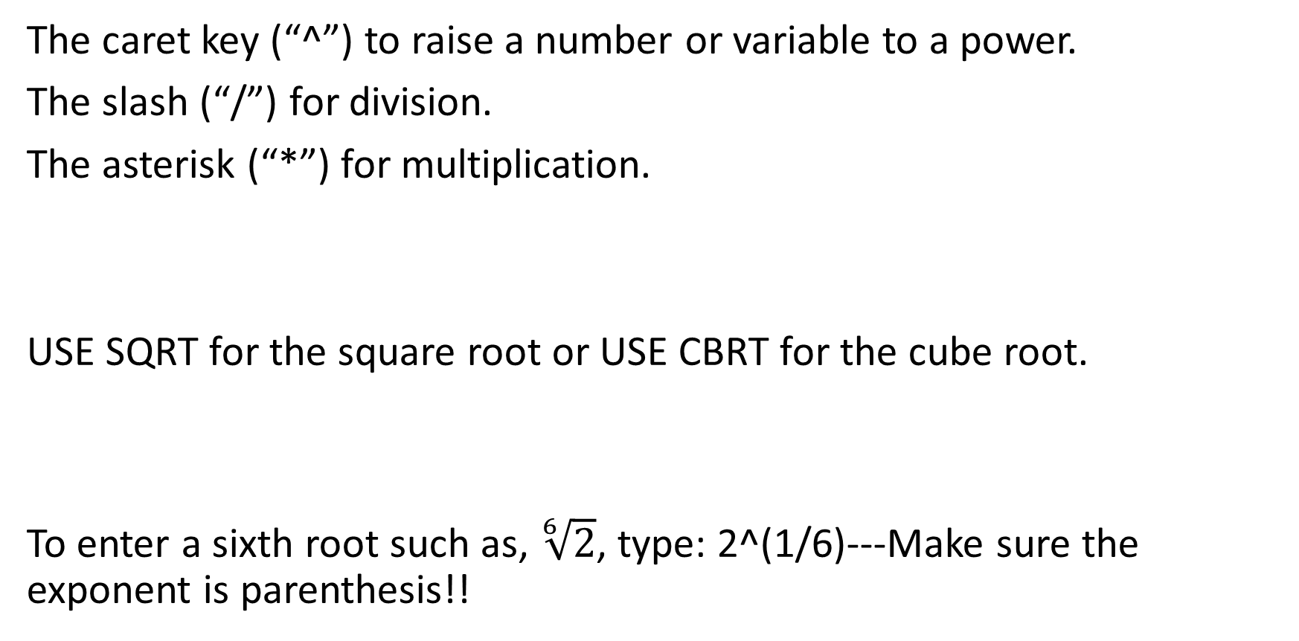
Inputting Usage
The caret key (“^”) to raise a number or variable to a power.
The slash (“/”) for division.
The asterisk (“*”) for multiplication.
USE SQRT for the square root or USE CBRT for the cube root.
To enter a sixth root such as, $\sqrt[6]{2}$, type: 2^(1/6)---Make sure the exponent is parenthesis!!

Slide 7
If you make a mistake in entering an expression, look at the end of the input line and click on the up/down arrow icon. Your entry or entries will come up and select the desired one to correct.

Slide 8
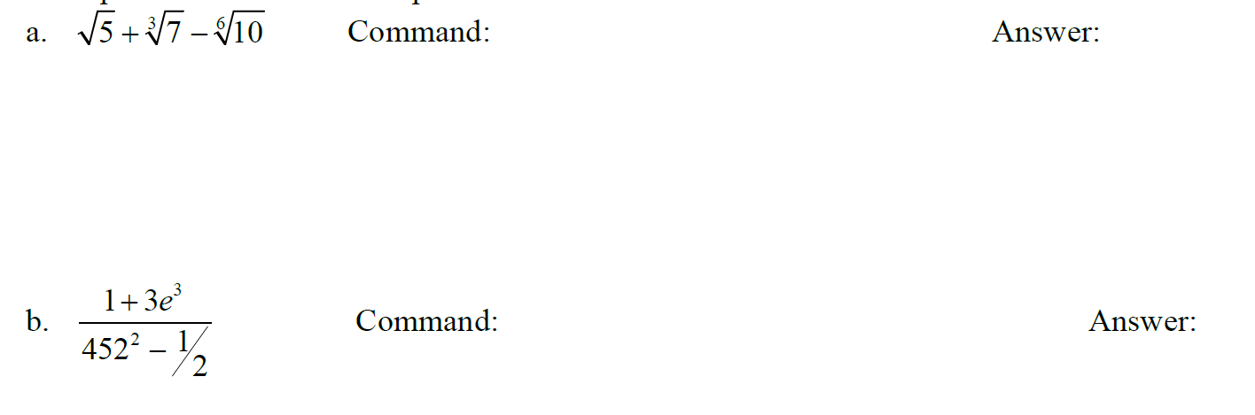


Example 1: Use GGB to compute:
sqrt(5)+cbrt(7)-10^(1/6)
(1+3e^3)/(452^2-(1/2))

Slide 9
Example 2:
The path of a small rocket is modeled by the function h(t) = -16t² + 128t + 12
The model gives the height of the rocket in feet, t seconds after launch. Find the height of the rocket:
a. 2 seconds after launch.
b. 4 seconds after launch.
c. 5 seconds after launch.
d. 8 seconds after launch.

Slide 10
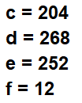
Begin by entering the function in the input line…
Command:
Command for a: h(2) Answer:
Command for b: h(4) Answer:
Command for c: h(5) Answer:
Command for d: h(8) Answer:
h(t)=-16t^2+128t+12

Slide 11
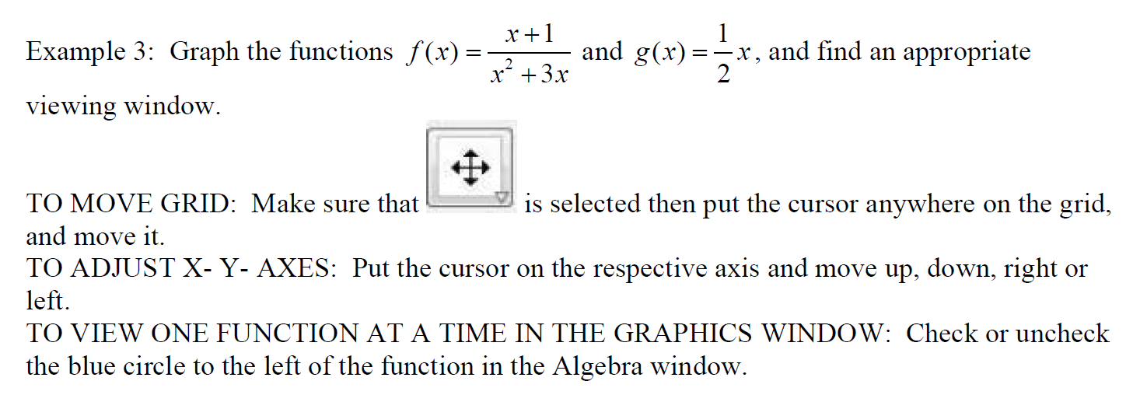
Graphing:
f(x)=(x+1)/(x^2+3x)
g(x)=(1/2)*x

Slide 12
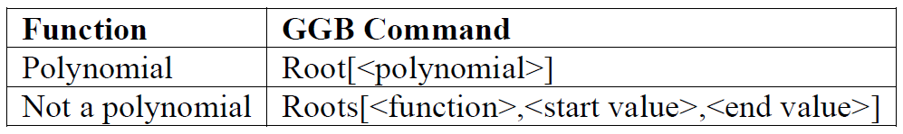
Finding Some Features of Graphed Function
You can find the zeros (also called roots or x intercepts) of a function using GGB. The command will depend on if the function is a polynomial or not.

Slide 13
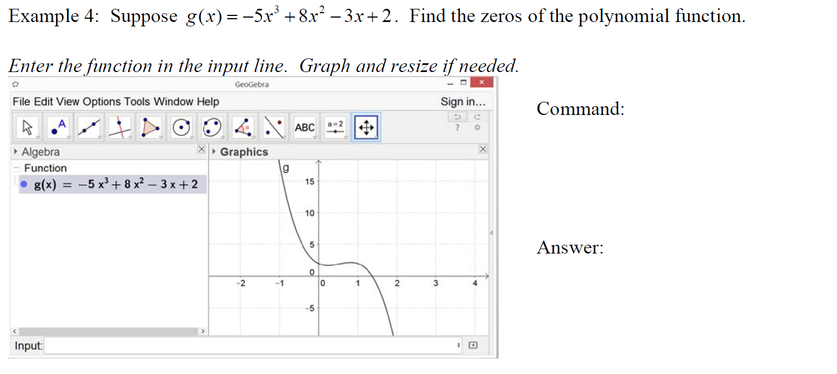

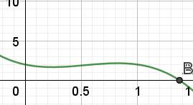
root(g(x))

Slide 14
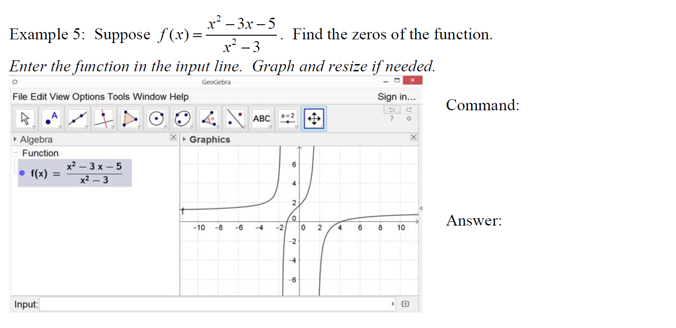

roots(f(x),-2,0)
roots(f(x),3,5)

Slide 15
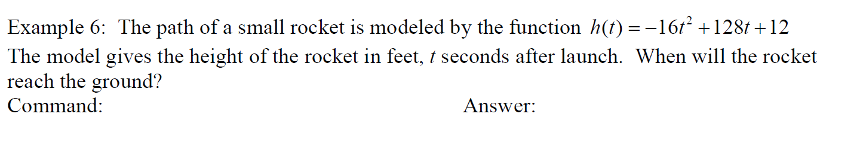

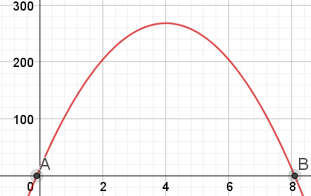
root(h(t))

Slide 16
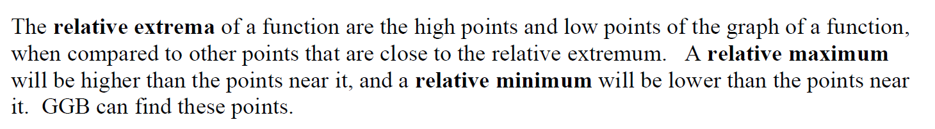
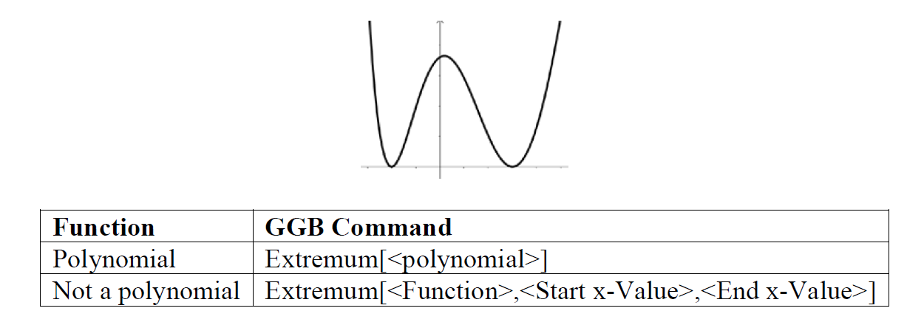

Slide 17
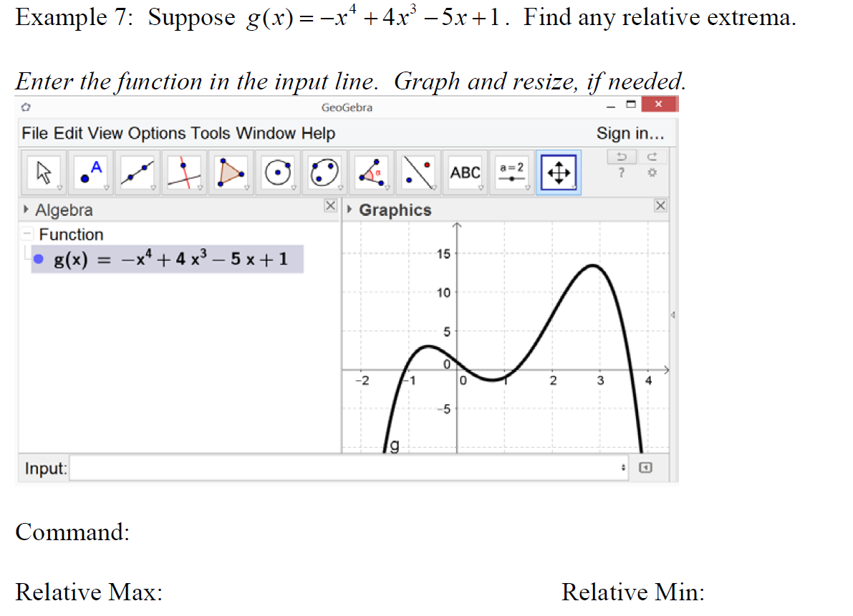
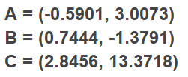
Extremum(g(x))

Slide 18
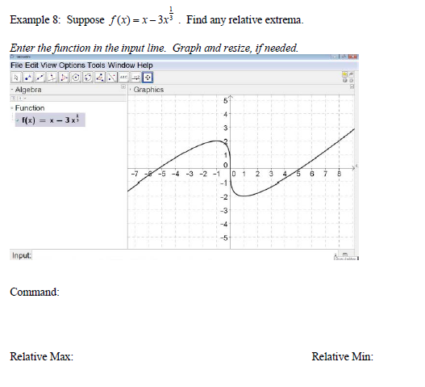

Extremum(f(x), -2, 2)

Slide 19

Intersection of Two Functions

Slide 20
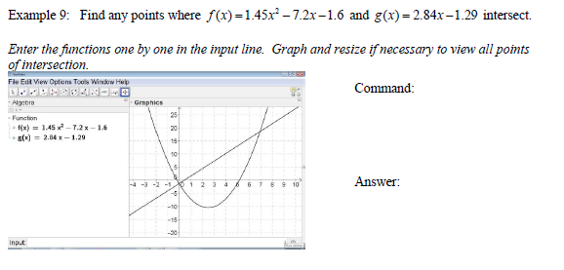

Intersect(f(x), g(x))

Slide 21
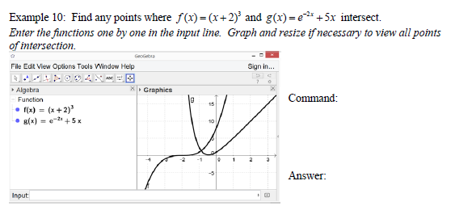

Intersect(f(x), g(x), -2, 0)

