Slide 1
MATH 1314
Lesson 20
Area Between Two Curves

Slide 2
The General “Formula” for area between two curves is:

Slide 3
integral(-x^2+4,-1,1)
integralbetween(0,x^2-4,-1,1)

Slide 4
integral(f(x)-g(x),-.07,6.46)
integralbetween(f(x),g(x),-.07,6.46)

Slide 5
Limits of Integration are not given:

Slide 6
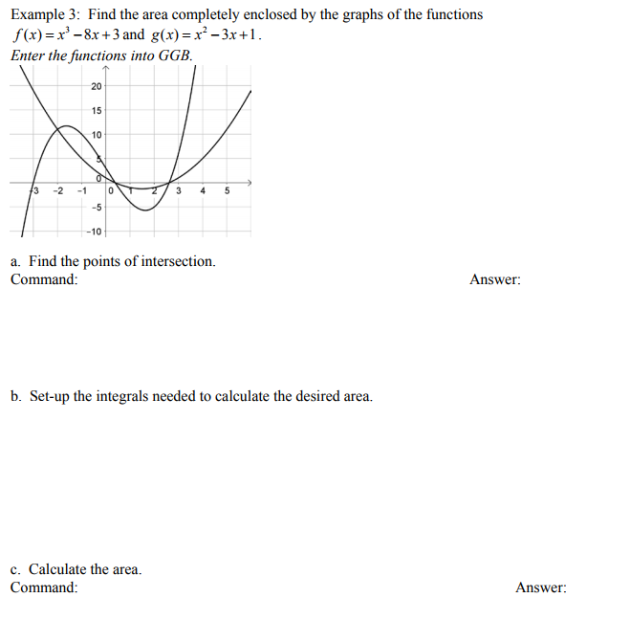
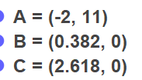
IntegralBetween(f(x), g(x), -2, 0.382)+integralbetween(g(x),f(x),.382,2.618)
intersect(f(x),g(x))

Slide 7
integral(-3x^3,-3,0)+integral(3x^3,0,3)

Slide 8
Popper 24:
Determine the total area bounded by the graphs of
f(x) = e^{-x} and g(x) = x³ – 2x² – x + 2
Determine the left intersection point.
Determine the middle intersection point.
Determine the right intersection point.
0.791 b. -0.336 c. 2.041 d. -0.562 e. 0.454

Slide 9
Popper 24: Continued
4. Set up the correct integral for the first region of area.
5. Set up the correct integral for the second region of area.
$\int_{−0.562}^{0.791}{x^{3}−2x^{2}−x+2 −e^{−x}dx}$
b. $\int_{−0.562}^{0.791}{{e^{−x}−x}^{3}+2x^{2}+x−2 dx}$
c. $\int_{0.791}^{2.041}{x^{3}−2x^{2}−x+2 −e^{−x}dx}$
d. $\int_{0.791}^{2.041}{{e^{−x}−x}^{3}+2x^{2}+x−2 dx}$
6. Determine the total area.
a. 0.184 b. 0.875 c. 1.567 d. 0.691

Slide 10
Applications:

Slide 12
integralbetween(f(t),g(t),0,5)

Slide 13
integralbetween(g(t),f(t),0,10)

Slide 14
Popper 25:
Evaluate the following:
$\int_{−1}^{2}{xe^{−x}dx}$
$\int_{−1}^{0}{xe^{−x}dx}$
$\int_{0}^{2}{xe^{−x}dx}$
Find where f(x) = xe^{-x} crosses the x-axis.
Find the total area bounded by the graph and the x-axis [-1,2].
a. 0 b. -1 c. 1.594 d.0.594 e. -0.406

Slide 15
Popper 25…continued
6. Why is the definite integral from -1 to 2 not equal to the area between -1 and 2?
Definite integrals do not always give area
Part of the graph is above the x-axis and part is below
Area only applies to positive intervals
You cannot integrate exponential functions

