Slide 1
MATH 1314
Lesson 21
Other Applications of Integration

Slide 2
Consumer Surplus and Producer Surplus

Slide 3
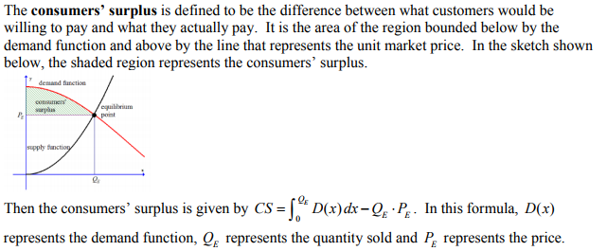

Slide 4
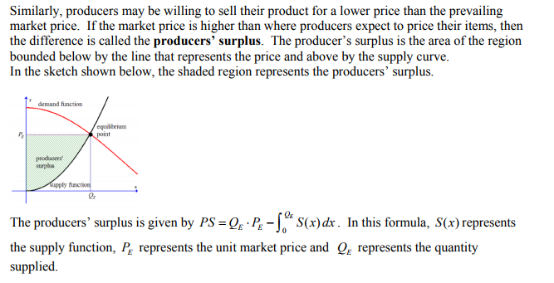

Slide 5
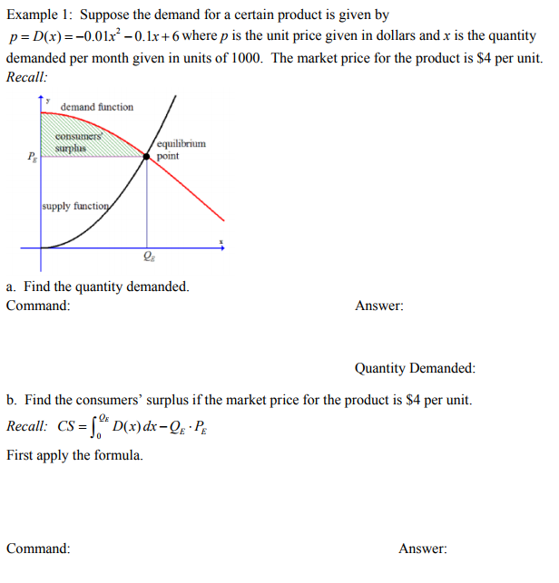
solve(d(x)=4)

Slide 6
integral(d(x),0,10)-10*4

Slide 8
Intersect(d(x), s(x))

Slide 9
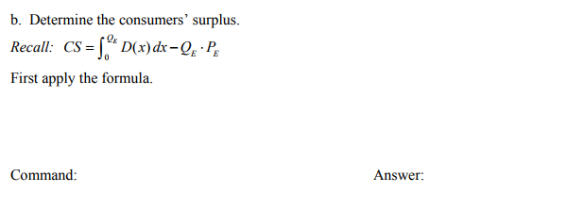
integral(d(x),0,20)-20*15

Slide 10
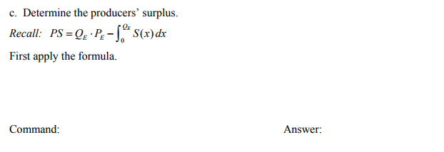
(15*20)-integral(s(x),0,20)

Slide 11
Probability

Slide 13
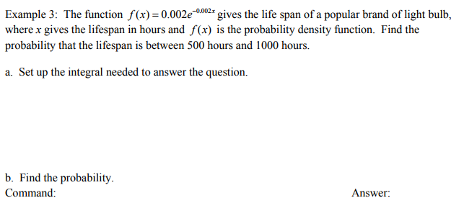
integral(f(x),500,1000)

Slide 14
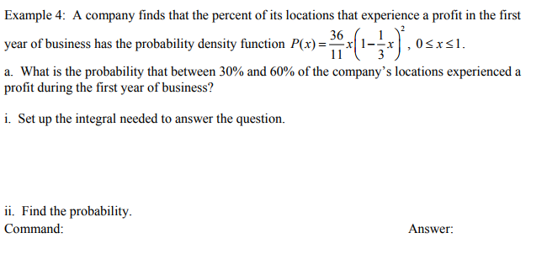
Integral(p(x),0.3,0.6)

Slide 15
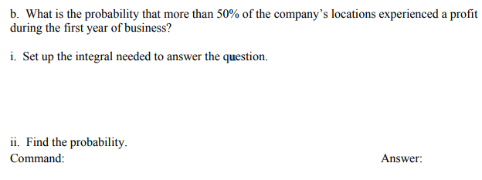
Integral(p(x),0.5,1)

Slide 16
Popper 26:
The demand function of a product is given by d(x)=-.2x² + 2x + 4 and the supply function is given by s(x) = 0.04x². Determine the consumer and producer surplus at market price.
Determine the equilibrium price.
Determine the equilibrium quantity.
Determine the Q_{E}P_{E} value.
Determine the consumer surplus.
Determine the producer surplus.
a. 40 b. 33.33 c. 4 d. 26.67 e. 10

