Slide 1
MATH 1314
Lesson 22
Functions of Several Variables
(Yes, you read that right!)

Slide 2
Functions of Two Variables

Slide 3
f(x,y)=x*e^(2x)-5x*y^2+ln(x*y)
f(-1,-3)

Slide 4
f(6,20)

Slide 5
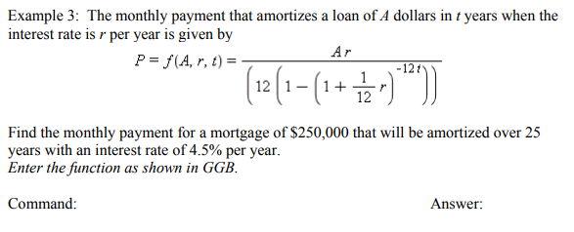

Slide 6
No denominators
No even roots
Domain: All real x, y

Slide 7
Note: Answers to domain question should be given in set-builder notation:
{(x,y)|conditions}

Slide 9
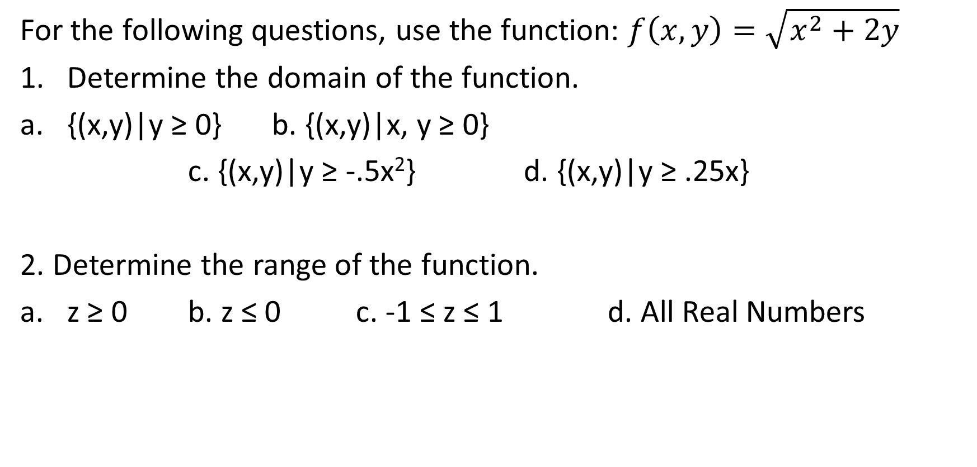
Popper 27:
For the following questions, use the function: $f\left(x,y\right)=\sqrt{x^{2}+2y}$
Determine the domain of the function.
{(x,y)|y ≥ 0} b. {(x,y)|x, y ≥ 0}
c. {(x,y)|y ≥ -.5x²} d. {(x,y)|y ≥ .25x}
2. Determine the range of the function.
z ≥ 0 b. z ≤ 0 c. -1 ≤ z ≤ 1 d. All Real Numbers

Slide 10

Popper 27:
For the following questions, use the function: $f\left(x,y\right)=\sqrt{x^{2}+2y}$
3. f(2, 5)
4. f(-3, 2)
5. f(0,-3)
6. f(0,0)
a. 3.7417 b. 0 c. 3.6056 d. 3.1623 e. undefined

