Slide 1
MATH 1314
Lesson 23
Partial Derivatives

Slide 2
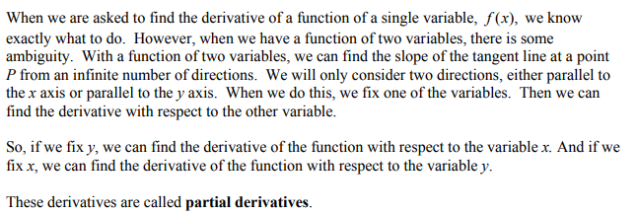
Partial Derivatives

Slide 3
First Order Partial Derivatives

Slide 4
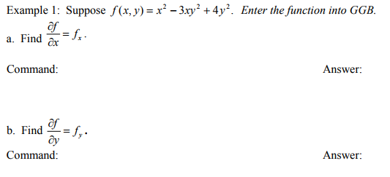
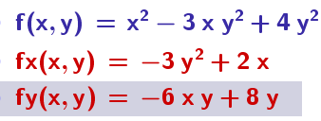
fx=Derivative(f(x, y),x)
fy=Derivative(f(x, y),y)

Slide 5
fx=derivative(f(x,y),x)
fy=derivative(f(x,y),y)

Slide 6
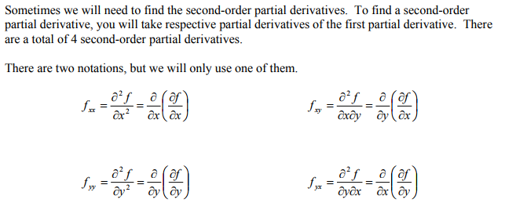
Second Order Partial Derivatives

Slide 7
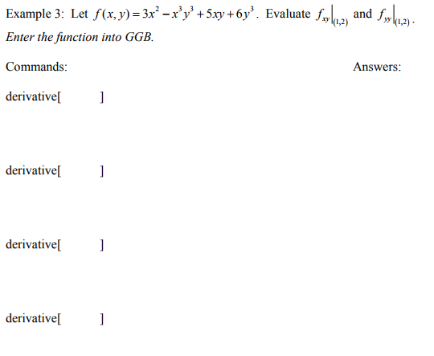
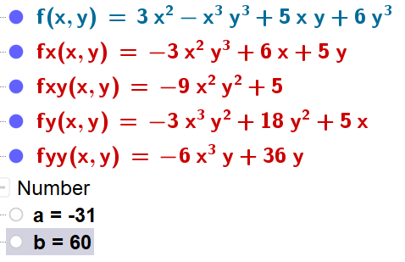
fx=derivative(f(x,y),x)
fy=derivative(f(x,y),y)
fxy(1,2)
fxy=derivative(fx(x,y),y)
fyy(1,2)
fyy=derivative(fy(x,y),y)

Slide 8
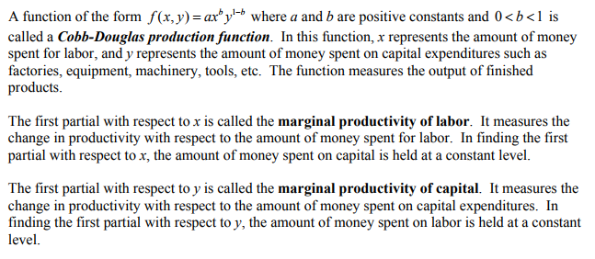

Slide 9
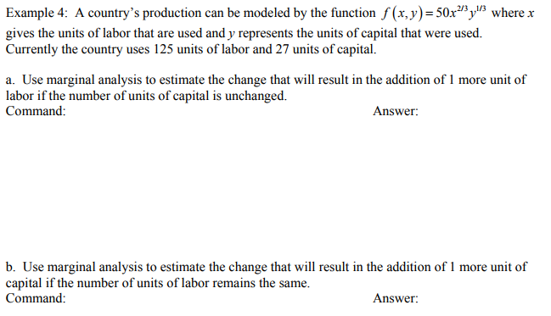
fx(x,y)=derivative(f(x,y),x)
fx(125,27)
fy(x,y)=derivative(f(x,y),y)
fy(125,27)

Slide 10
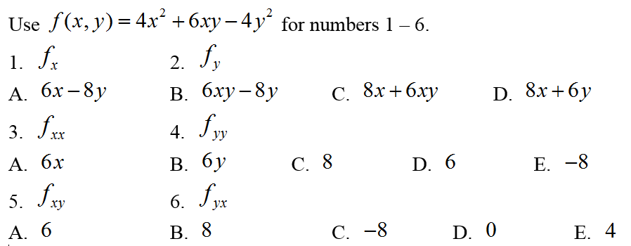
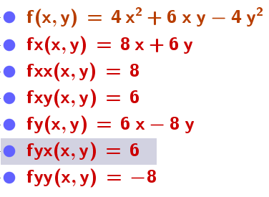
Popper 28

