Slide 1
MATH 1314
Lesson 23
Partial Derivatives

Slide 2
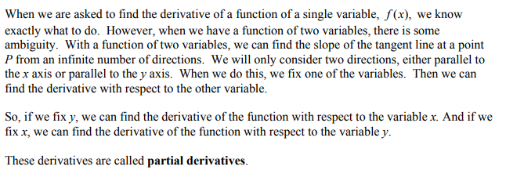
Partial Derivatives

Slide 3
First Order Partial Derivatives

Slide 4
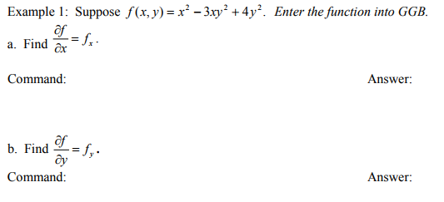
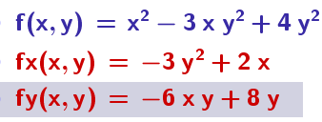
fx=Derivative(f(x, y),x)
fy=Derivative(f(x, y),y)

Slide 5
fx=derivative(f(x,y),x)
fy=derivative(f(x,y),y)

Slide 6
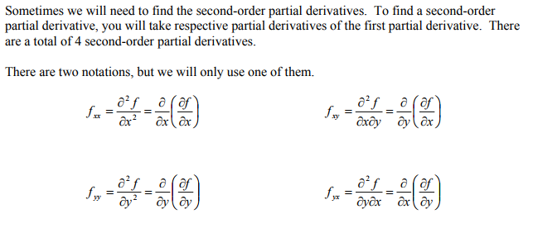
Second Order Partial Derivatives

Slide 7
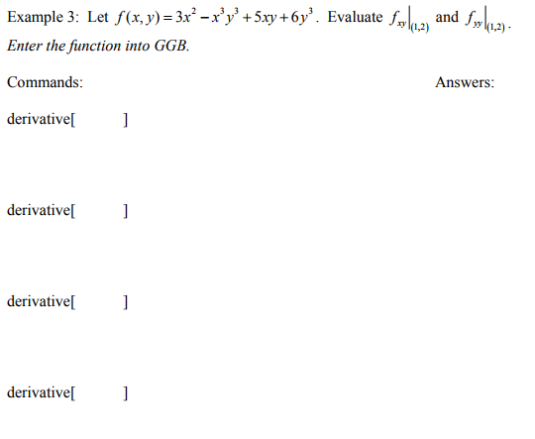

Slide 8
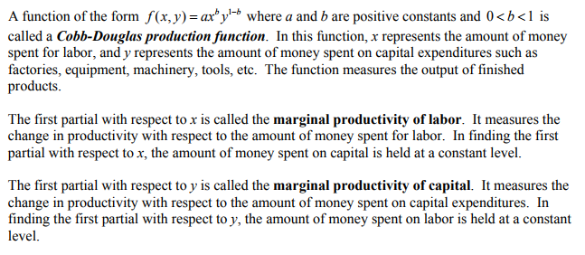

Slide 9
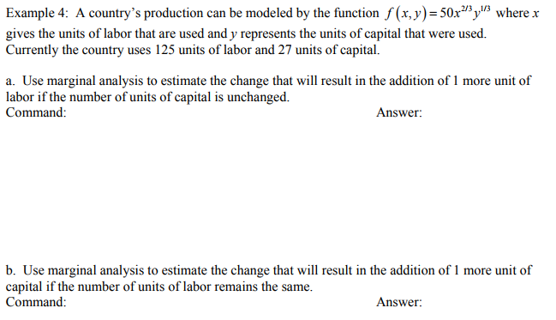

Slide 10
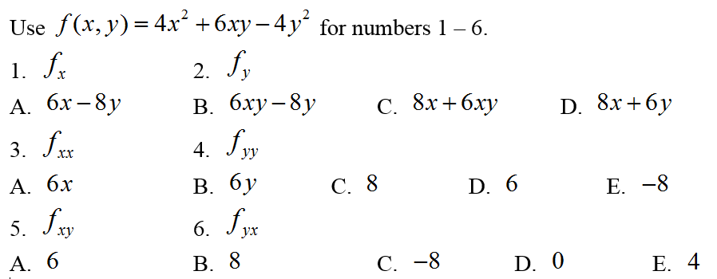
Popper 28

