Slide 1
MATH 1314
Lesson 24
Maxima and Minima of Functions of Several Variables

Slide 3
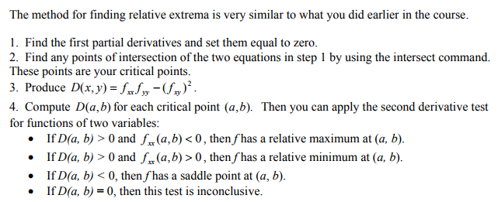

Slide 4
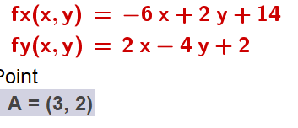
fx=derivative(f(x,y),x)
fy=derivative(f(x,y),y)
intersect(fx(x,y)=0,fy(x,y)=0)

Slide 6
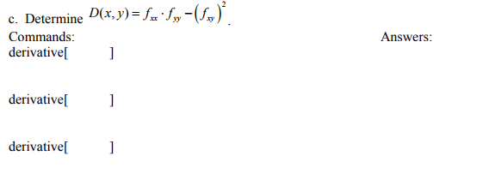
fxx=derivative(fx(x,y),x)
fyy=derivative(fy(x,y),y)
fxy=derivative(fx(x,y),y)
d(x,y)=fxx(x,y)*fyy(x,y)-(fxy(x,y))^2

Slide 7
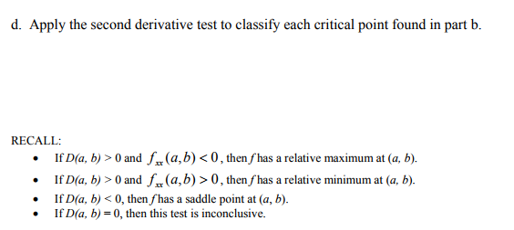

Slide 8
f(3,2)
This means that (3,2,15) is a relative maximum of f(x,y)

Slide 9
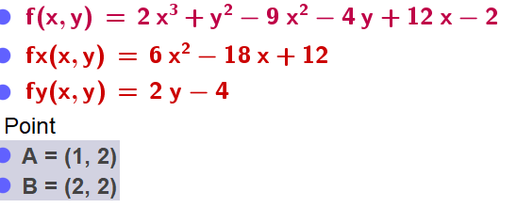

Slide 19
Popper 29:
Consider the graph of the function: f(x, y) = x² + y²
Determine f_{x}
Determine f_{y}
a. 2x + 2y b. 2x c. 2y d. 2 e. 0
3. Find the intersection of f_{x} and f_{y}.
a. (0,0) b. (0,2) c. (2,2) d. (2,0) e. (2,-2)
4. Determine D(x,y)
a. 0 b. 2 c. 4 d. 8 e. -2
Is the critical point the location of a maximum or minimum?
a. minimum b. maximum c. saddle point d. inconclusive
6. What is the maximum/minimum?
a. 0 b. 4 c. -4 d. 6 e. -10

