Slide 1
MATH 1314
Lesson 3

Slide 2
Regression Curves
When you are given raw data about a quantity, rather than a function, you will need to have a method for finding a function that “fits” the data that is given – that is, a function that passes through or passes close to many or most of the points of data that are given. These equations are called regression equations. You’ll be able to use GGB to find these.

Slide 3
Regression Syntax

Slide 4
Using Spreadsheet View

Slide 5
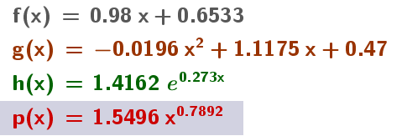
Fitpoly(L,1)
Fitpoly(L,2)
Fitexp(L)
Fitpow(L)

Slide 9
Linear regression model:
Command: Answer:
Quadratic regression model:
Command: Answer:
Exponential regression model:
Command: Answer:
Power regression model:
Command: Answer:

Slide 10
Goodness of Fit
You will also be asked to find a value for regression models called r². This value measures the “goodness of fit” for a regression model, and will be between 0 and 1. The closer the value is to 1, the better the linear regression model predicts the trend of the given data. The closer it is to 0, the less useful it will be in predicting future values. For our purposes in this class, they will give us a piece of information for determining how well a regression equation fits the underlying data.
The command is “RSquare[<List of points>, <Function>].

Slide 11
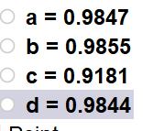
Example 2: Use the data and the quadratic regression model that you found in Example 1 to find value r².
Command: Answer:
Rsquare(L,f(x))
Rsquare(L,g(x))
Rsquare(L,h(x))
Rsquare(L,p(x))
The quadratic model was the best model for this data

Slide 13
Cubic Model:
Fitpoly(L,3)

Slide 14
Quartic Model:
Fitpoly(L,4)
g(x) = -0.0583x⁴ + 0.6296x³ - 1.7139x² + 1.9474x + 2.0825

Slide 15
f(2022-2014)

