Slide 1
MATH 1314
Lesson 4: Limits

Slide 2
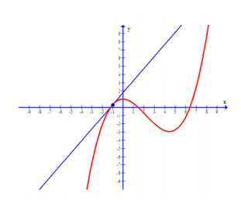
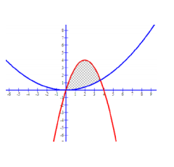
What is calculus?
Calculus is the study of change, particularly, how things change over time. It gives us a framework for measuring change using some fairly simple models. In this course, we will address two basic questions in this course.
How do we find the slope of a line that is tangent to an arbitrary curve at a given point?
How can we find the area of a region such as the one pictured below?
Both of these areas of inquiry rely on the concept of limits.

Slide 3
Limits:

Slide 4
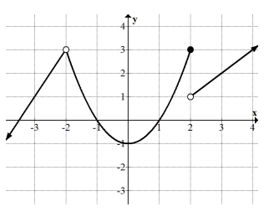
Example 1: Based on the graph below, find the following:
$$\lim_{x→0}{f(x)}$$
$$\lim_{x→2}{f(x)}$$
$$\lim_{x→−2}{f(x)}$$

Slide 8
Evaluating Limits: Most often, we will not have a graph given, and will need to find a limit by algebraic methods.

Slide 9
Substitution:
When substitution gives a value of k/0, the limit is considered as does not exist: DNE

Slide 10
Indeterminate Forms:

Slide 11
Example 9: The following limits are of the indeterminate form. Use GGB to evaluate the limit. Begin by entering the function into GGB.
limit(f(x),2)
1.75
limit(f(x),4)
0.25

Slide 12
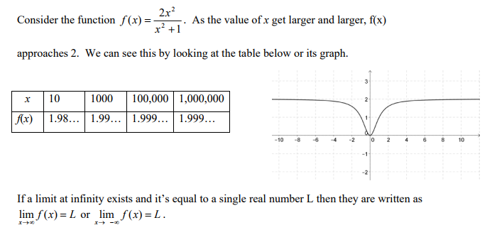
Limits at Infinity:
So far we have looked at problems where the target number is a specific real number. Sometimes we are interested in finding out what happens to our function as x increases (or decreases) without bound.

Slide 14
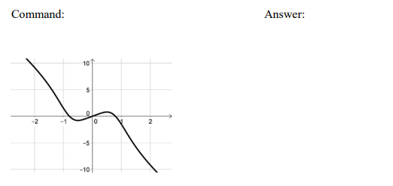
limit(f(x),infinity)
1.25
limit(f(x),-infinity)
0
limit(f(x),infinity)
-∞

Slide 15
limit(f(x),-infinity)
∞

Slide 16
Applications Involving Limits
Popper 1: Question 1:
Example 14:
The average cost in dollars of constructing each skateboard when x skateboards are produced can be modeled by the function:
$\overline{C}=12.5+\frac{123,500}{x}$. What is the average cost per skateboard if the number of boards produced gets larger?
a. 123500 b. 12.5 c. 0 d. DNE

Slide 17
Popper 1: Question 2:
Example 15: The concentration of a drug in a patient’s bloodstream t hours after the drug is administered can be modeled by the function: $f\left(t\right)= \frac{0.2t^{2}}{100t^{2}+t+1}$ where f(t) is given in mg/cc. Find the amount of the drug that is in the patient’s bloodstream as the amount of time since it was administered increases.
a. 0.2 b. 100 c. 0.001 d. 0.002

