Slide 1
MATH 1314
Lesson 5: One-Sided Limits and Continuity

Slide 2
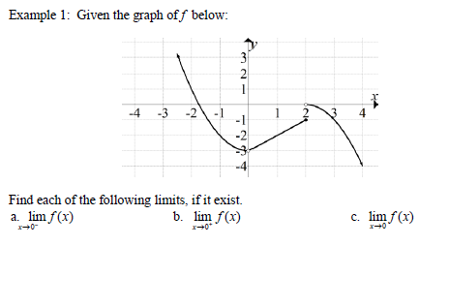

Slide 3
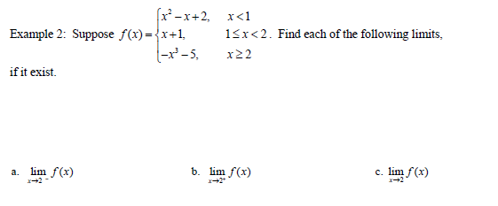
For evaluating one-sided limits in Geogebra:
LimitAbove(function,x-value) will give the limit from the right.
LimitBelow(function,x-value) will give the limit from the left.

Slide 4
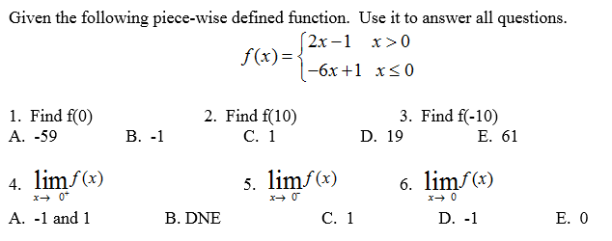
Popper 1:

Slide 5
Continuity at a Point

Slide 6
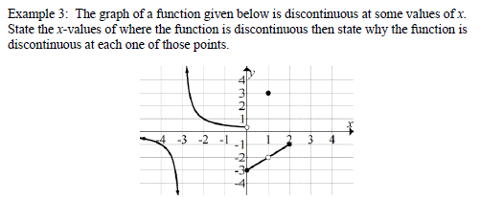
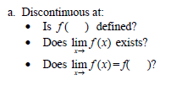
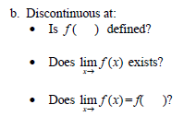
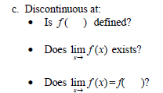

Slide 7
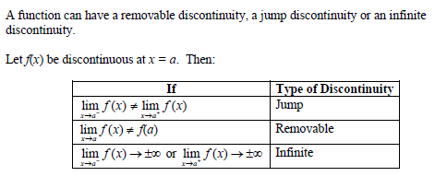
Types of Discontinuities

Slide 8
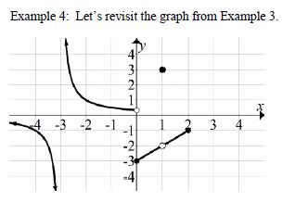
Identify the type of discontinuity located at:
x = -3
x = 0
x = 1

Slide 9
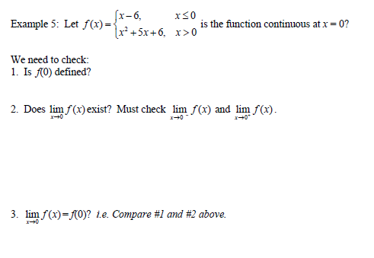

Slide 10
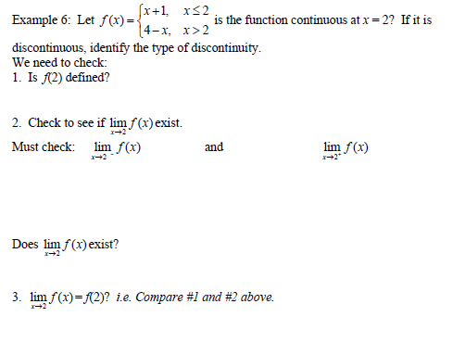

Slide 11
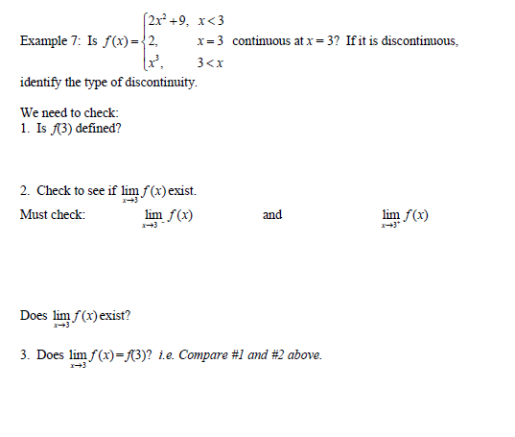

Slide 12
