Slide 1
MATH 1314
Lesson 6: Derivatives

Slide 2
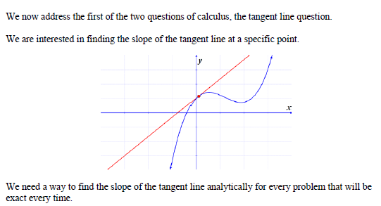
The Tangent Line Question

Slide 3
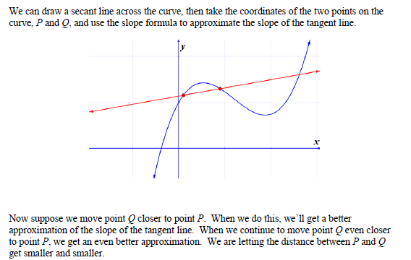
Secant Line to Tangent Line
https://www.desmos.com/calculator/bxk8b4uotw

Slide 4
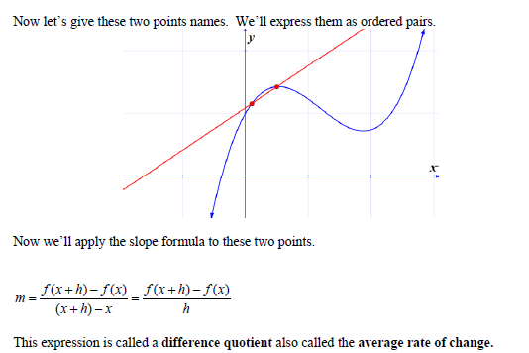

Slide 7
Popper 2:
Finding the slope of the tangent line uses:
slope of the secant line b. the difference quotient
c. the use of limits d. all of the above
Complete the following statement:
$$\left(Question2\right)=Question(3)\frac{Question (4) −Question(5)}{Question (6)}$$
a. f(x) b. h c. f’(x) d. f(x+h) e. $\lim_{h→0}{}$

Slide 8
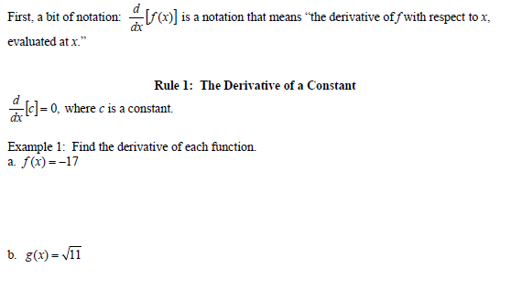
Rules for Finding Derivatives

Slide 9
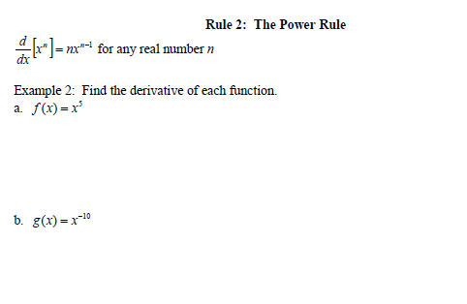
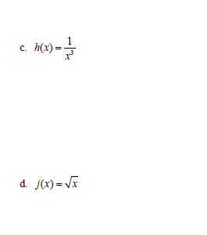

Slide 10
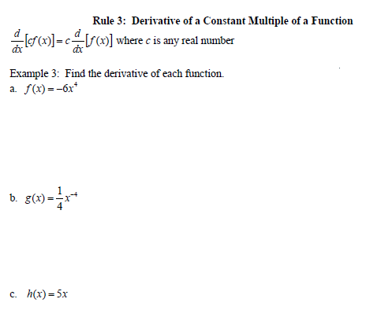

Slide 11
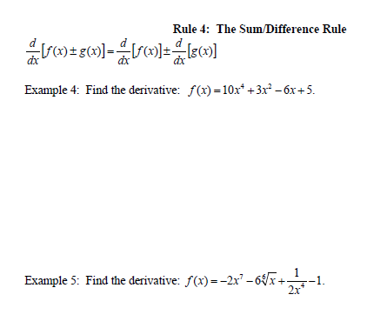

Slide 12
The Second Derivative

Slide 13
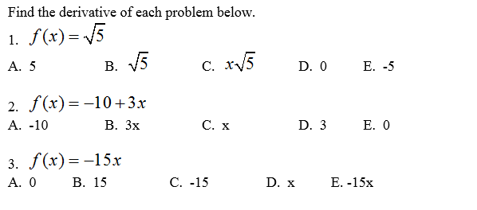
Popper 3:

Slide 14
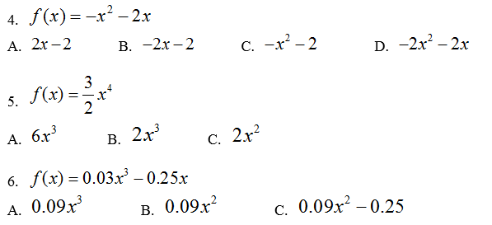
Popper 3…continued:

