Slide 1
MATH 1314
Lesson 7: Applications of the Derivative

Slide 2
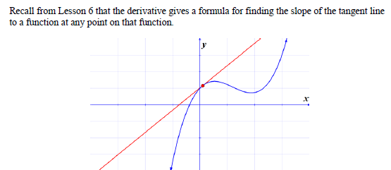
Meaning of a Derivative:

Slide 3
f’(4)

Slide 4
tangent(3,f(x))

Slide 5
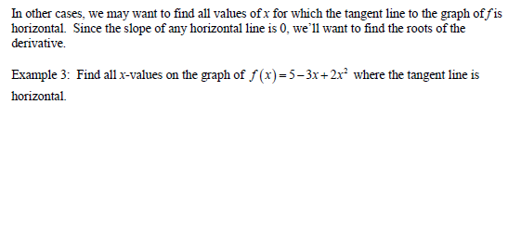
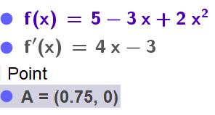
f’(x)
root(f’(x))

Slide 6
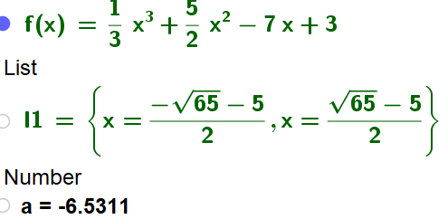
solve(f’(x)=3)
(-sqrt(65)-5)/2
(sqrt(65)-5)/2

Slide 7
f(x)=(x^2*ln(x))/((x^2+3)^(1/3)
f’’(5)

Slide 8
Popper 4
Find the slope of the tangent line at the given x-value.
f(x) = 3x² – x at x = -1
-5 B. -1 C. -7 D. 6
2. f(x) = -x² – 2x at x = 0
-2 B. -1 C. 2 D. 1
3. f(x) = x³ + x² at x = 2
A. -2 B. 10 C. 2 D. 16
f’(-1)
f’(0)
f’(2)

Slide 9
Popper 4 Continued
4. Find all values of x for which the slope of the tangent line to the function is horizontal: f(x) = -x² – 2x
-2 B. -1 C. 2 D. 1
5. Find all values of x for which the slope of the tangent line to the function is horizontal: f(x) = x² + 4x
-4 B. -2 C. 0 D. 4
6. Find all values of x for which the slope of the tangent line to the function is horizontal: f(x) = -10x⁵
A. -10 B. -1 C. -50 D. 0
root(f’(x))

Slide 10
Word Problems:

Slide 11
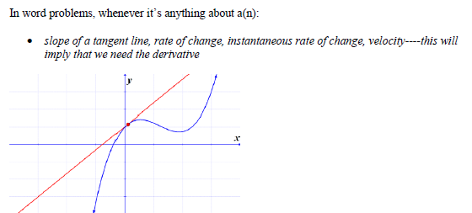
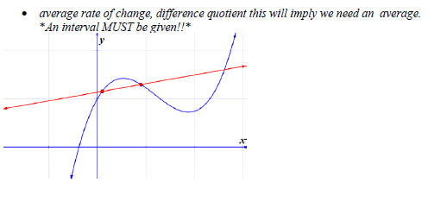
Instantaneous vs. Average Rate of Change

Slide 12
Position, Velocity, and Acceleration

Slide 13
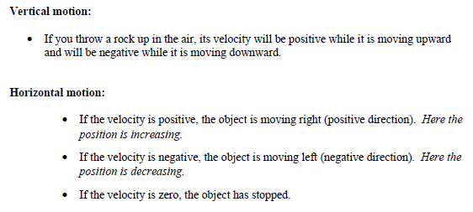

Slide 17
(f(6)-f(1))/(6-1)

Slide 18
Free Fall

Slide 27
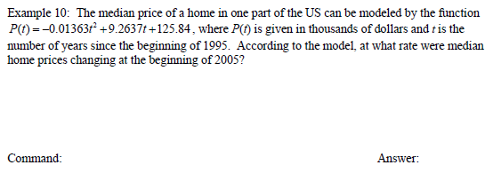

Slide 29
Popper 5:
The function d(t) = 4t² + 32t models the distance covered by a car t seconds after starting from rest.
Find the distance covered by the car after 3 seconds.
Find the distance covered by the car after 5 seconds.
150 B. 180 C. 108 D. 260 E. 132
3. Find the velocity of the car when t = 4.
Find the velocity of the car when t = 7.
A. 88 B. 64 C. 48 D. 60 E. 55

Slide 30
Popper 5 Continued:
The function d(t) = -t³ + 15t² + 32t models the distance covered by a car t seconds after starting from rest.
5. Find the acceleration of the car when t = 3.
6. Find the acceleration of the car when t = 4.
A. 63 B. 6 C. 75 D. 12 E. 204

