Slide 1
MATH 1314
Lesson 8: Break Even Analysis, Equilibrium Quantity/Price

Slide 2
Cost Functions:

Slide 3
Revenue Functions:

Slide 4
Profit Functions:

Slide 5
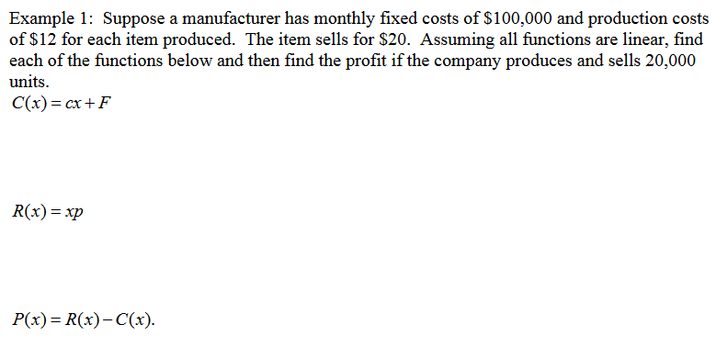
Example 1:

Slide 6
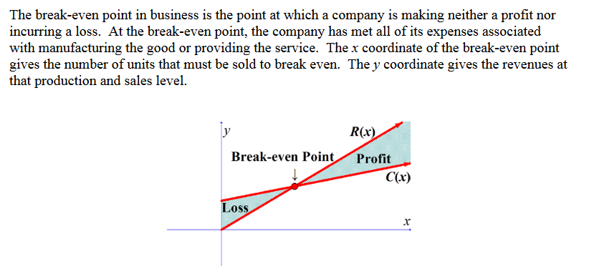
Break-Even Analysis

Slide 7
Example 2:
Find the break-even point for the problem in Example 1.
Command: Answer:
Intersect(c(x), r(x))

Slide 8
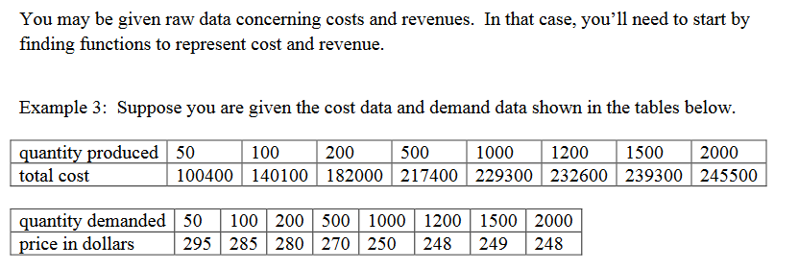
fitpoly(L,1)

Slide 9
fitpoly(l1,1)

Slide 10
R(x)=x*g(x)

Slide 11
Intersect(f(x),r(x))
You will earn profit when producing between 716 and 8472 items

Slide 12
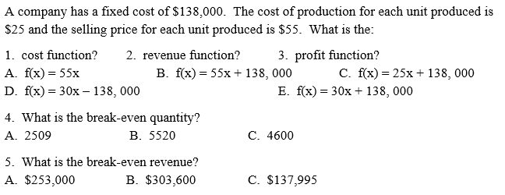
Popper 6:

Slide 13
Market Equilibrium:

Slide 14
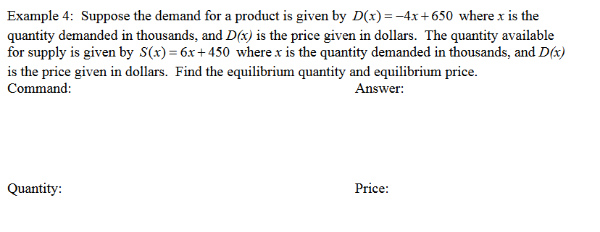

Slide 15
