Slide 1
MATH 1314
Lesson 9: Marginal Analysis

Slide 2
Marginal Cost
c(101)-c(100)

Slide 3
c'(100)
When asked to use marginal analysis, use the derivative evaluated at the value less than the one you are interested in.
For the cost of the 150th item, use c’(149)

Slide 5
c'(24)

Slide 6
Average Cost and Marginal Average Cost

Slide 7
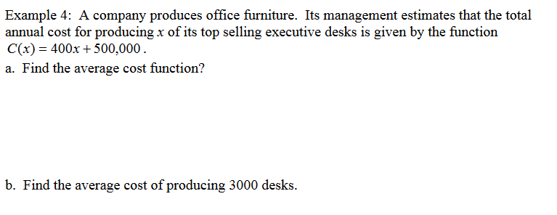
cbar(3000)

Slide 8
Marginal Revenue

Slide 9
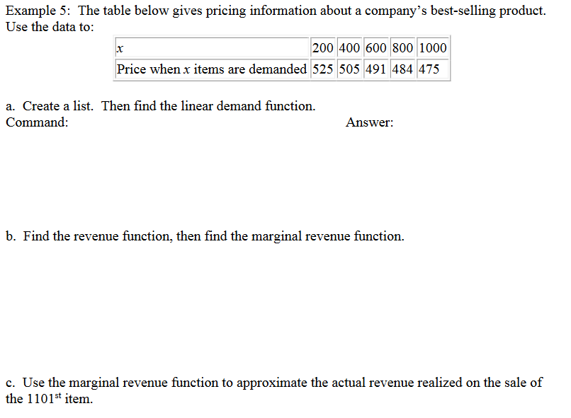
fitpoly(L,1)
r'(1100)

Slide 10
Marginal Profit:

Slide 11
p'(52)

Slide 12
Popper 8:
The cost function for producing x items is C(x) = -0.2x² + 1000x + 20000, and the revenue of producing x items is R(x) = 30x.
Determine the marginal cost function.
Determine the average cost function.
Determine marginal revenue function.
Determine the profit function.
30 b. 0.2x² – 970x – 20000
c. -0.4x + 1000 d. -0.2x + 1000 + (20000/x)

Slide 13
Popper 8…continued:
5. Determine the cost of producing the 501st item.
6. Determine the average cost of producing the 500 items.
a. $47800 b. $800 c. $15000 d. $940

