Slide 1
MATH 1314
Test 2 Review
15 Multiple Choice Questions

Slide 2
root(f(x))
extremum(f(x))
Maximum
Minimum
f'(-0.25)
f''(-0.25)

Slide 3
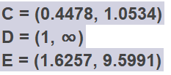
roots(f(x),-1,1)
Extremum(f(x), 0, 2)
Maximum
Minimum

Slide 4
fitpoly(L,3)
rsquare(L,f(x))
f(2010-2003)
fitexp(L)

Slide 7
limit(f(x),-2)
limit(f(x),0)

Slide 8
limit(f(x),infinity)
limit(f(x),-infinity)
limit(f(x),infinity)

Slide 9
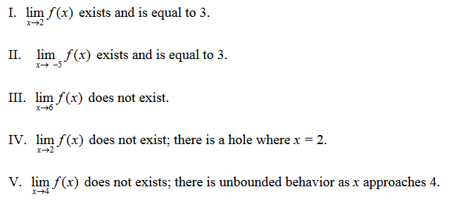

Slide 11
tangent(3,f(x))

Slide 12
(f(4)-f(1.5))/(4-1.5)

Slide 14
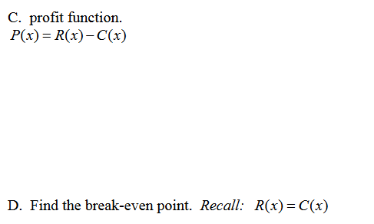

Slide 15
fitpoly(L,1)
Intersect(f(x), r(x))
fitpoly(M,1)

Slide 17
intersect(s(x),d(x))

Slide 18
Popper 7
For questions 1 – 5 fill out Answer Choice E

