Slide 1
MATH 1314
Test 3 Review

Slide 2
r'(233)

Slide 3
cbar(x)=c(x)/x
cbar(130)
or
c(130)/130

Slide 4
f(p)=-25p+25000
e(p)=-p*f’(p)/f(p)
e(535)
Elastic (e(p)>1): meaning that a raise in price will decrease demand

Slide 5
N(3)

Slide 6
fitexp(L)
f’(10)

Slide 11
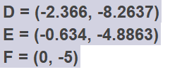
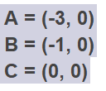
root(f’(x))
f(-3)
f(-1)
inflectionpoint(f(x))

Slide 12
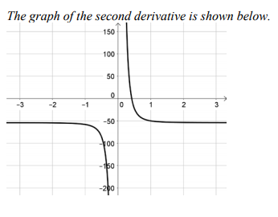
Roots(f'(x), -1, 1)
f(-.3333)
roots(f’’(x))

Slide 14
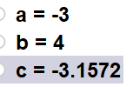

Slide 15
extremum(a(x))
Dimensions: 10x10x5, surface area:300

Slide 16
Dimensions:
x = 100, y = 150
Area:
15000
extremum(a(x))

