Slide 1
MATH 1314
Test 4 Review

Slide 3
RectangleSum(f(x), 1, 9, 6, .5)

Slide 4
UpperSum(f(x), -2, 2, 50)

Slide 5
integral(f(x))

Slide 6
Integral(f(x), 1.3, 1.5)

Slide 7
integral(f(t),2,3)

Slide 8
1/7*integral(c(t),0,7)

Slide 9
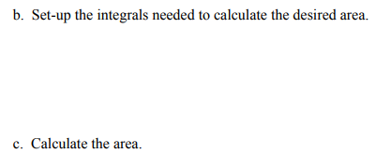
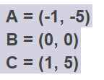
integralbetween(f(x),g(x),-1,0)+integralbetween(g(x),f(x),0,1)
intersect(f(x),g(x))

Slide 10
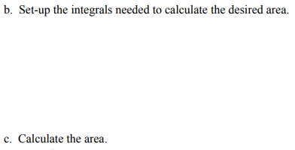
integralbetween(s(x),c(x),0,6.3607)
intersect(s(x),c(x))

Slide 11
solve(d(x)=8)
integral(d(x),0,13.75)-8*13.75

Slide 12
integral(f(t),0,7)

Slide 13
f(8,6)

Slide 14
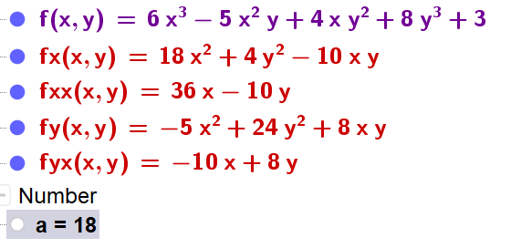
fx=derivative(f(x,y),x)
fy=derivative(f(x,y),y)
fxx=derivative(fx(x,y),x)
fyx=derivative(fy(x,y),x)
fyx(-1,1)

Slide 15
fy=Derivative(f(x, y),y)
fy(1100,775)

Slide 16
fx=derivative(f(x,y),x)
fy=derivative(f(x,y),y)
intersect(fx=0,fy=0)

Slide 17
d(x,y)=fxx*fyy-(fxy)^2
d(-0.2869,-0.1913)
d(0.4647,0.3098)
fxx(0.4647,0.3098)

Slide 18
f(0.2042,0.0893)

